Slide 1


Whitelands College
Est: 1841
orientation

Slide 2



Introduction from Dr Nick Mayhew-Smith, Head of Whitelands College

Slide 3

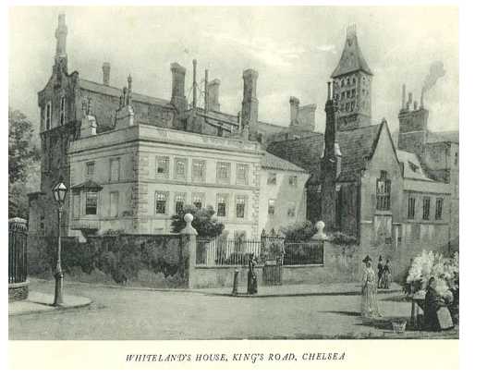
Whitelands College
Whitelands College is one of the oldest higher education institutions in England, predating every university except Oxford, Cambridge, London and Durham. The Church of England’s National Society founded the College in 1841 as a teacher training college for women. It took its name from Whitelands House, a Georgian building in the King's Road, Chelsea, previously used as a school.
The stated aim of the new establishment was 'to produce a superior class of parochial schoolmistresses'. During the early years the conditions at Whitelands were cramped and unsanitary and students were forced to work long hours with little or no leisure time.

Slide 4
A little bit of our College History
First college building (1842 – 1930) - Chelsea – Kings Road, Walpole Street. (The college was originally based in, and named after, a Georgian building, Whitelands House, on King's Road, Chelsea. The original house was demolished and rebuilt in 1890 to meet the requirements of a growing number of students.
Second College building (1930 – 2005) – Putney - Melrose Road, Sutherland Grove. Beverley gate house, a hall of residency on the Puntney site. (The new Whitelands College was formally opened by Queen Mary in 1931. The extensive campus was expanded over the following years, with additional residential and academic buildings constructed on site.)
College evacuation during WWII – Students evacuated to Durham University, a Gilesgate Suburb in Durham.
Third College (2005 – Present) – Parkstead House – Roehampton (house was originally built in the early 1760s for the 2nd Earl of Bessborough, and was extended and renamed Manresa House after becoming a Jesuit novitiate in the mid-nineteenth century)

Slide 5

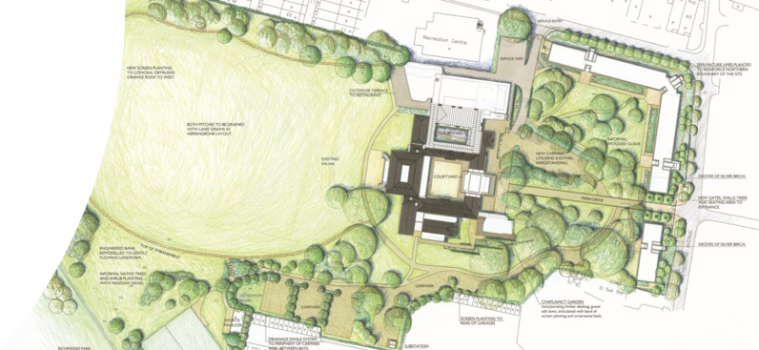
A unique area with beautiful views
Parkstead house was built in the 1760s

Slide 6


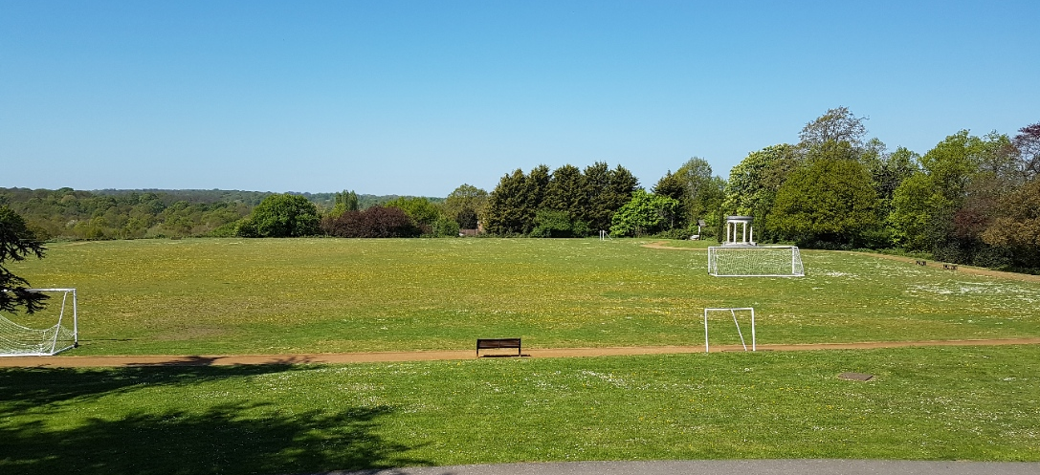
Insta-perfect Views From The SETT

Slide 7
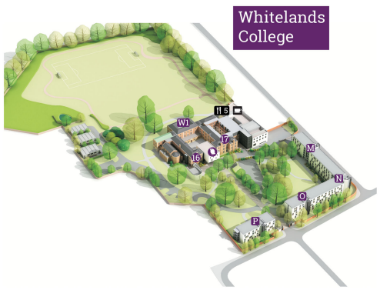

Our Campus Grounds

Slide 8
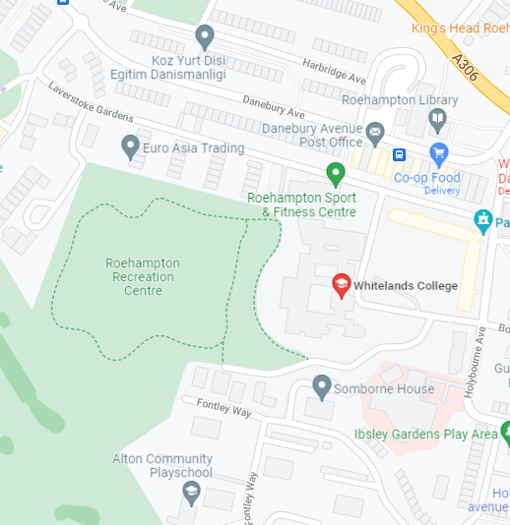
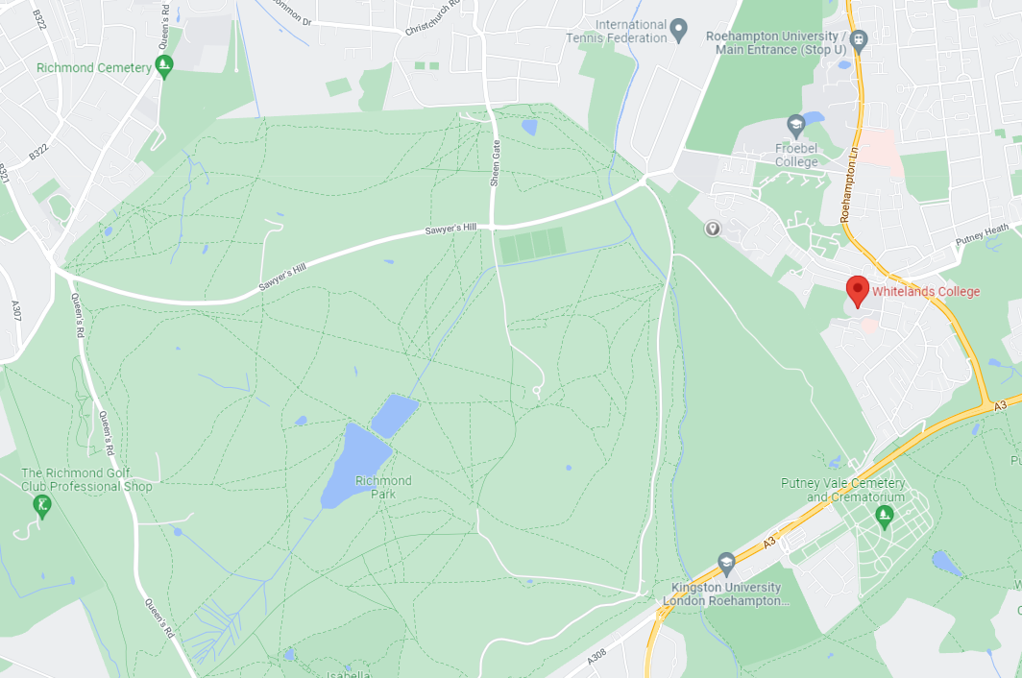
A large open space to relax
Richmond Park

Slide 9
Our Facilities
What does Whitelands College have to offer you?

Slide 10
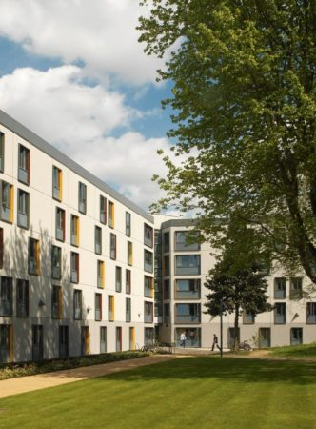
On-Site Accommodation
Five to Twelve person flats with shared kitchen and living space
Small double bed
Private bathroom
Wall access port for internet (LAN)
But why all the names?

Slide 11
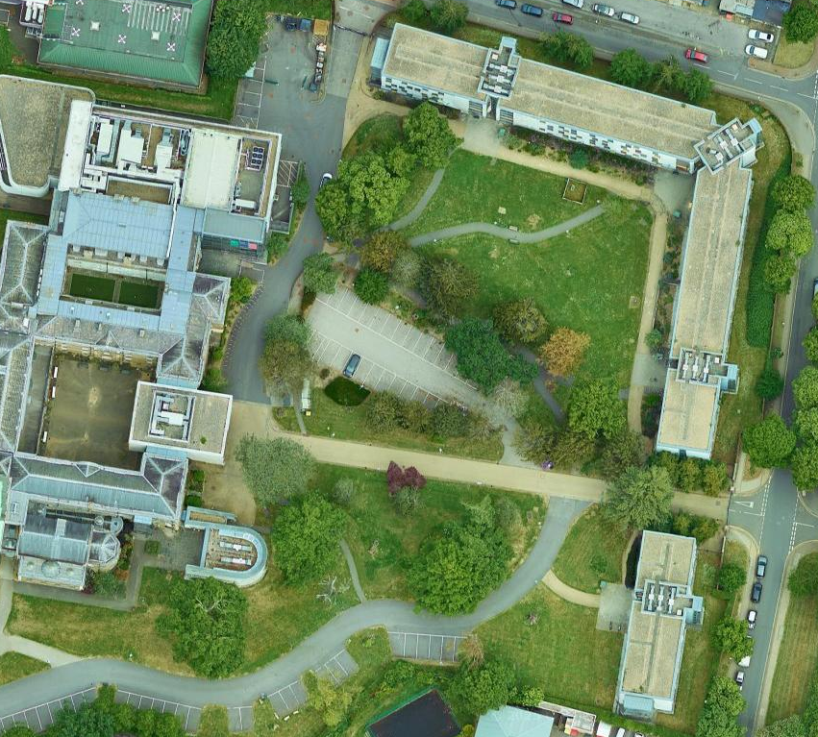
College Accommodation Names
Cheltenham
Beverley
Durham
Durham
Gilesgate
Cheltenham - named after Cheltenham Terrace, which bordered the north-east (ish) side of Whitelands in Chelsea
Beverley - Named after Beverley Gate House - a hall of residence on the Putney site
Durham - Where the College was evacuated to in WWII
Gilesgate - Suburb in Durham, where the College was evacuated to in WWII
Kings - Named after Kings road, the main road of the Putney Site
Melrose - Named after Melrose Road, opposite the Putney site
Sutherland - Named after Sutherland Grove, the access road leading into the Putney site
Walpole - Named after Walpole Street, which bordered the south-west side of Whitelands in Putney
Kings
Melrose
Sutherand
Walpole

Slide 12
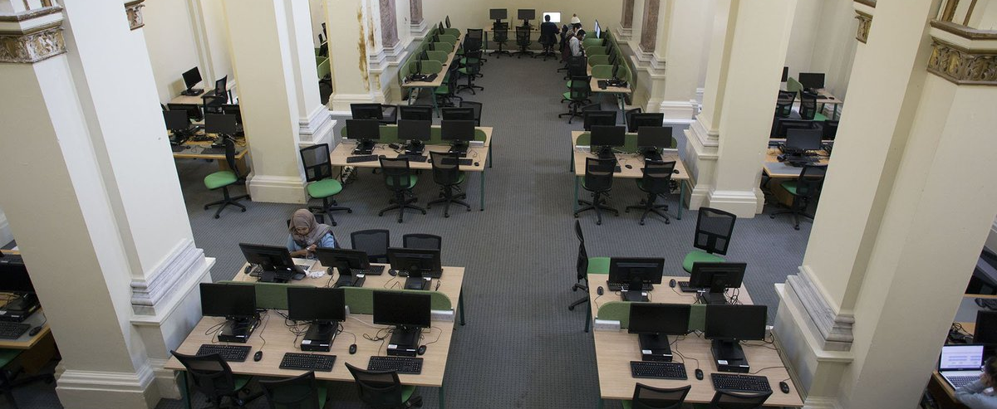
On Site computer suite

Slide 13
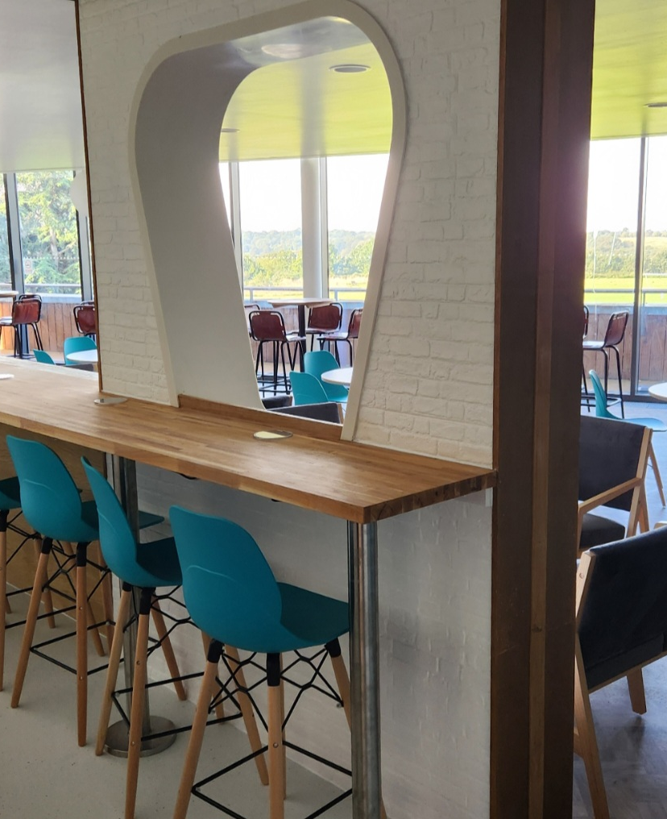
Newly remodeled On-site student bar/Common Room (SETT)

Slide 14
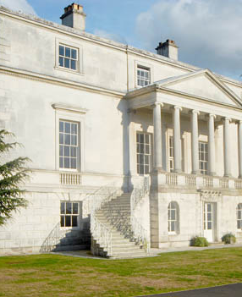
24-hour security and on-site Warden

Slide 15

Residential Block Leaders
Residential Block Leaders are here to support the residential community at Whitelands College
There is normally at least one Residential block Leader per dorm building– there are posters for you to check who your Residential Block Leader is
If you are interested in becoming a Residential Block Leader, please email Steven.Taggart@roehampton.ac.uk for more information.

Slide 16

Whitelands Guild

Slide 17

Who's who of Whitelands

Slide 18



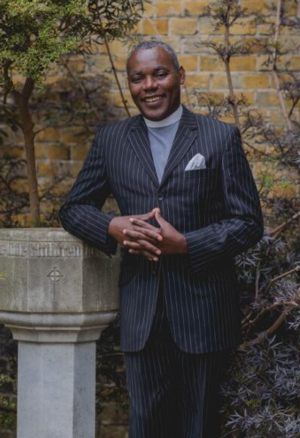
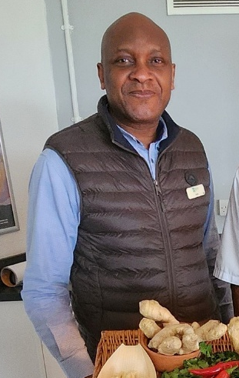


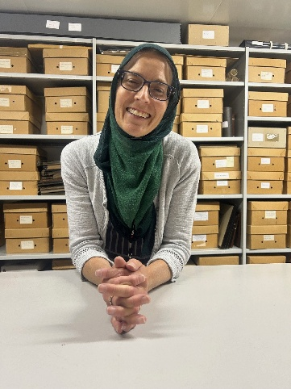
Your Whitelands College Team
Senior College Warden
Olivia Ogunbunmi
Student Leadership Manager
Steven Taggart
Head of College
Dr Nick Mayhew-Smith
Dean of Chapel
Dr Daniel Eshun
Head of Catering
Wale
Archivist
Gemma Bentley
SWO
Amy Watts
SWO
Olwen Ottaway

Slide 19
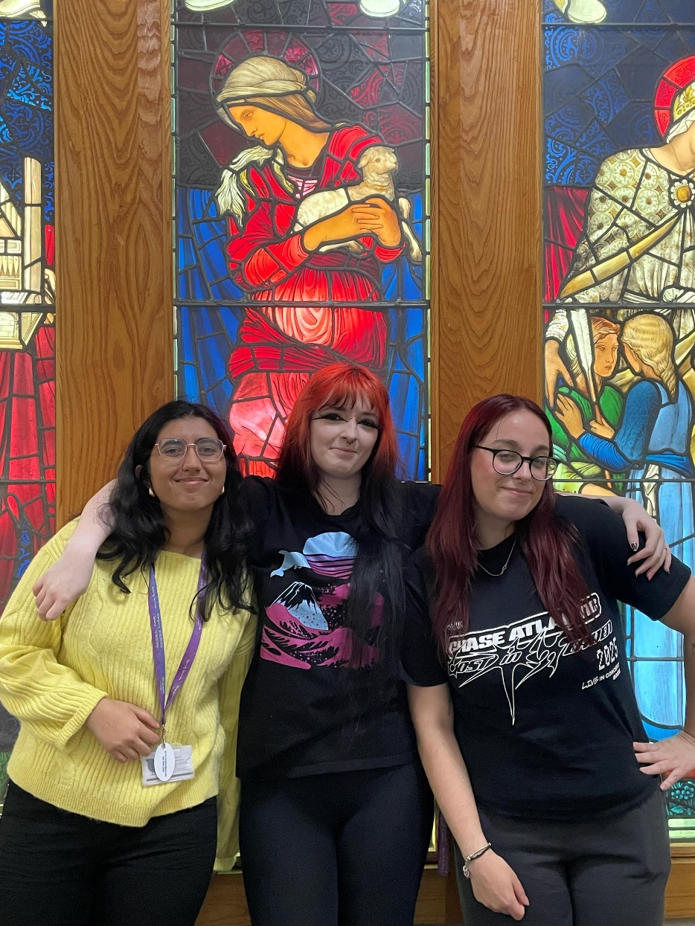
Residential Community Leaders (RCLs)
Zara, Courtney & Jenna

Slide 20



Your Student Elected Officers
Carlo Ruiz Gago
Student Deputy President
Keira Williams
Queen Keira
146th May Monarch
Mariyam Mehmood
Student President

Slide 21
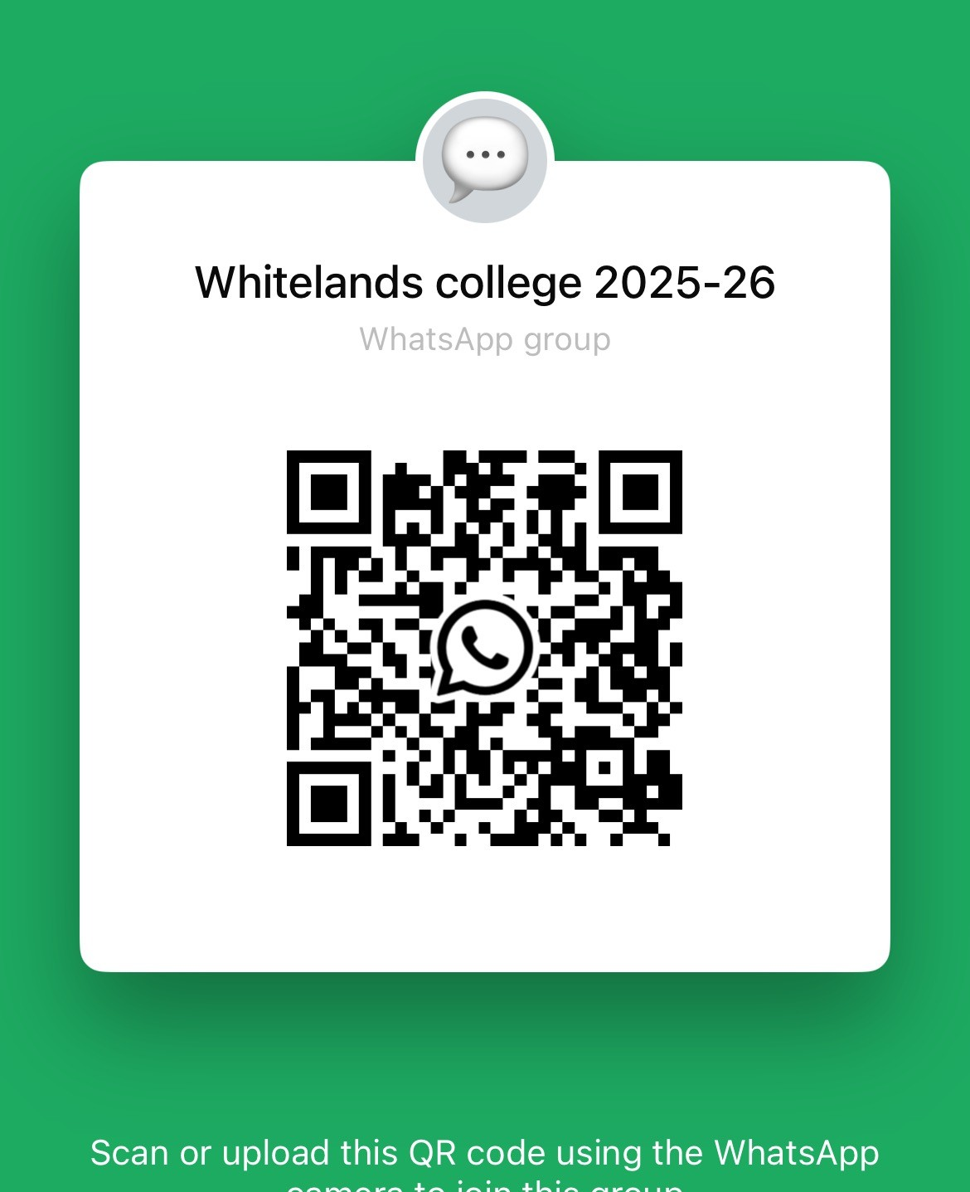
Whitelands
Student Led Community Chat

Slide 22


Our College Mascot
Minnie
K9 Staff Leader and Lead Squirrel Inspector

Slide 23
Students Union

Slide 24

Whitelands Annual Premier event

Slide 25
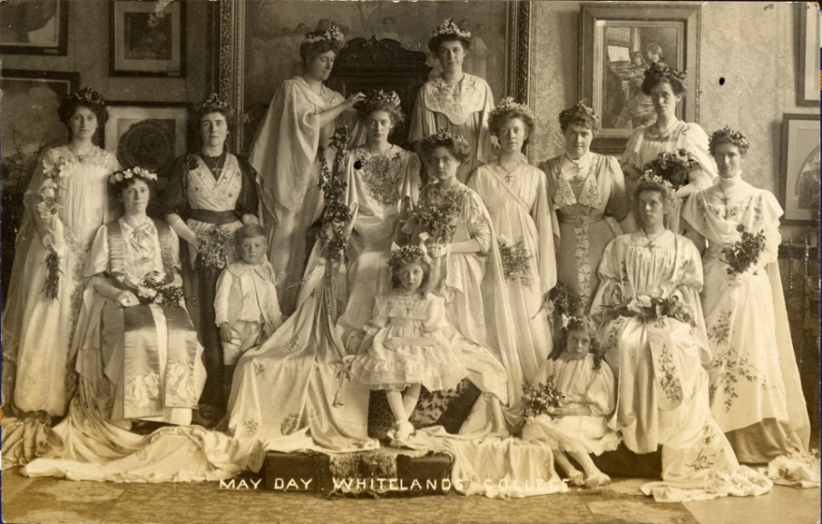
Annual May Day Celebration
Est: 1881

Slide 26
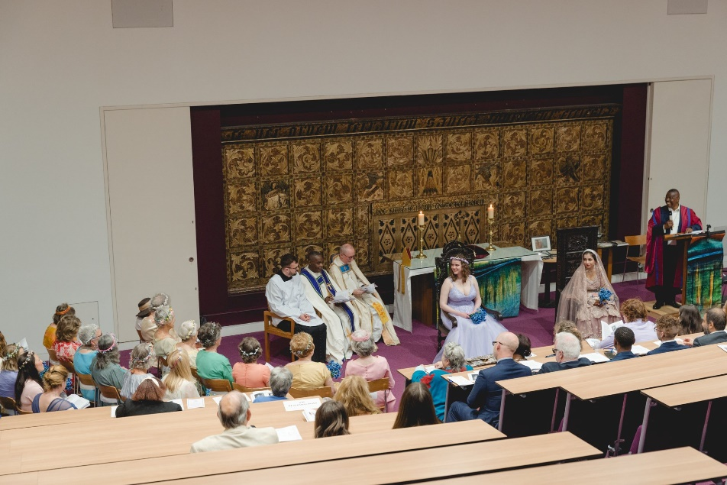


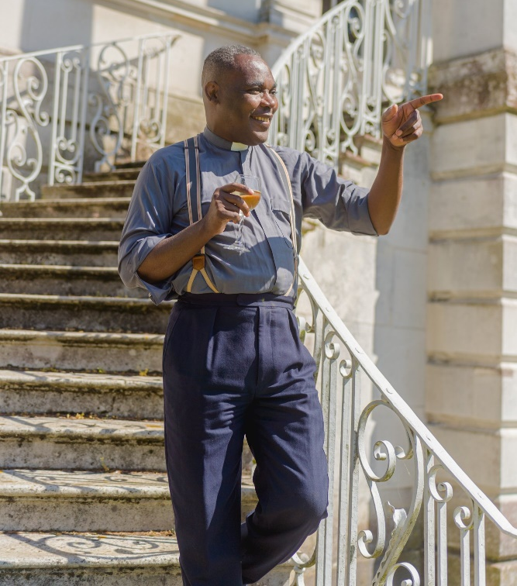
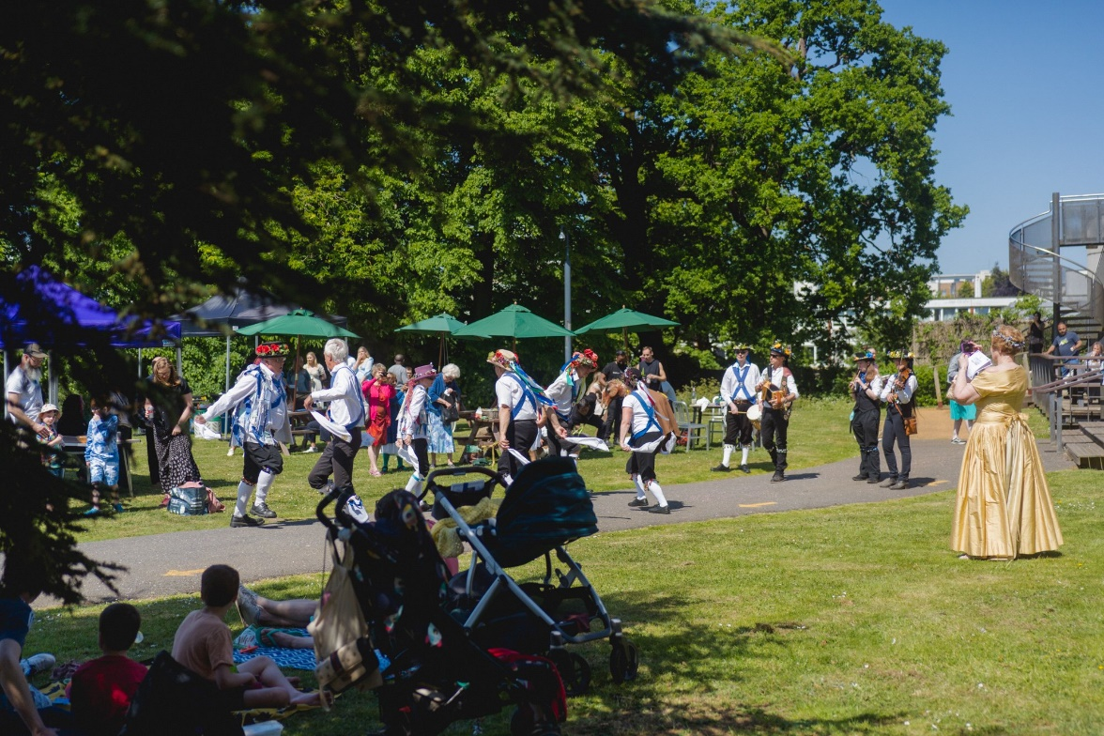
May-Day: 2022

Slide 27
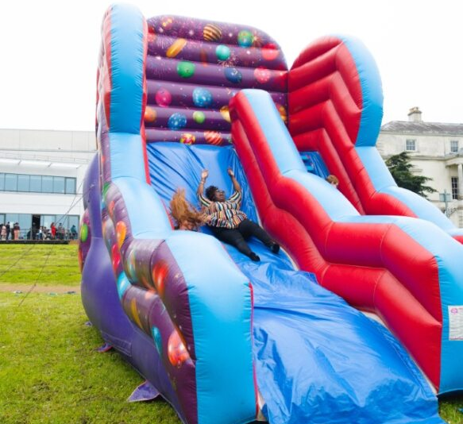

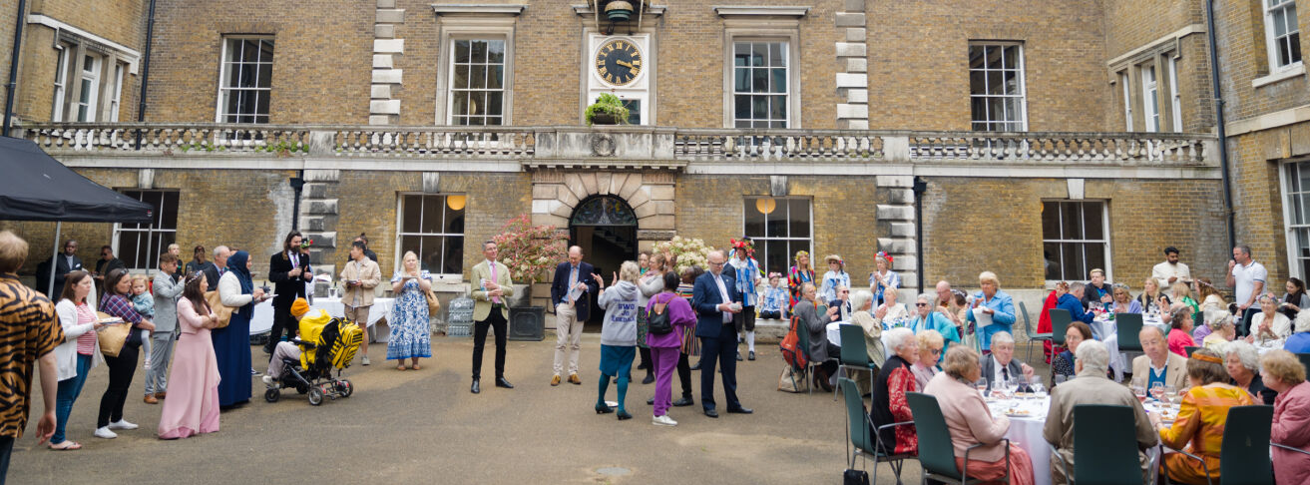

Slide 28


Slide 29

STUDENT WELLBEING SERVICES

Slide 30






MEET THE WELLBEING OFFICERS
Based in each of our four Colleges, our Student Wellbeing Officers are friendly, supportive staff who can help with guidance on emotional support resources, and direct students to internal and external teams or services that can help address any wellbeing-related issues students are going through.
Annie
Lead Student Wellbeing Officer
(interim)
Amy P
Digby (AHSS, SETEC students and students in Digby accommodation)
Rosanna
Digby (Nursing & Healthcare students) / Froebel (Education students and students in Froebel accommodation)
Oli
Whitelands (Psychology and students and students living in Whitelands accommodation)
Colin
Southlands – Business school and students in Southlands accommodation
Amy W
Whitelands (Life Science students and students in Whitelands accommodation)
& Business school and students in Southlands accommodation

Slide 31
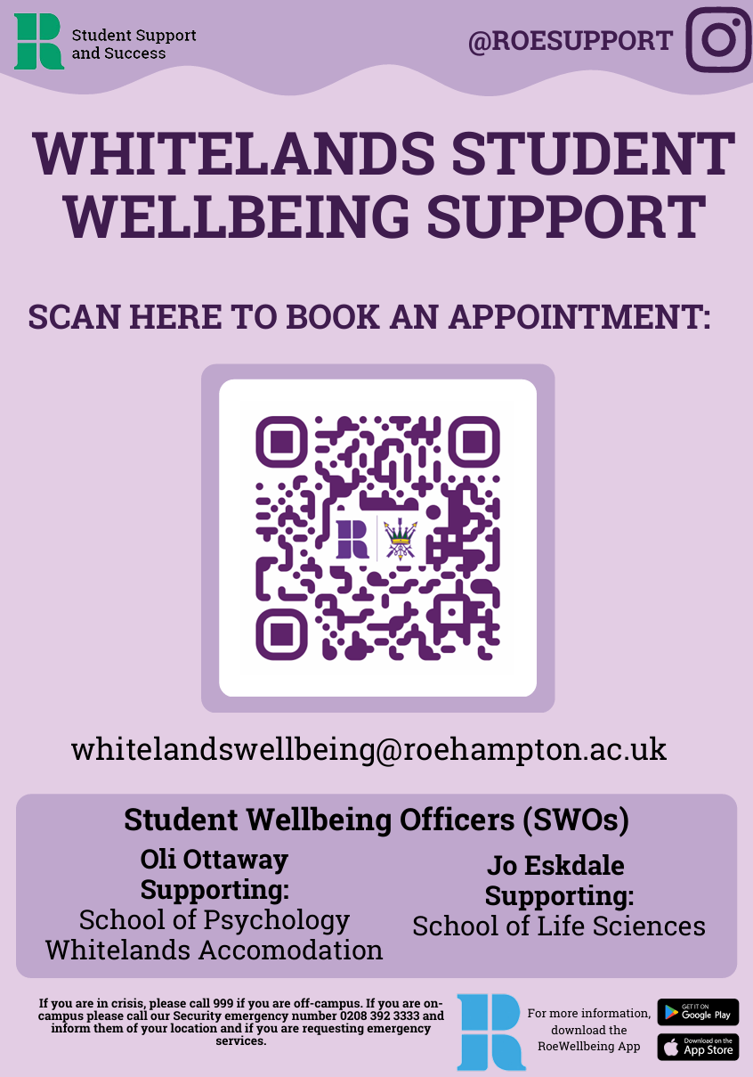
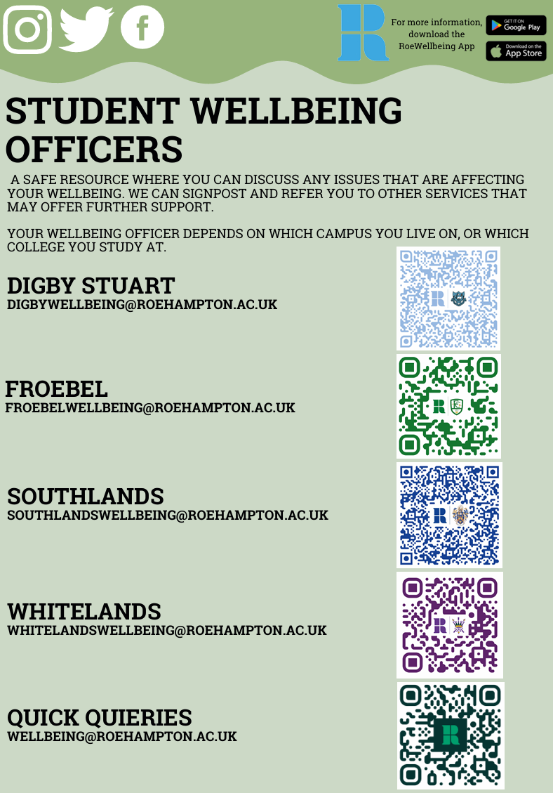

Slide 32
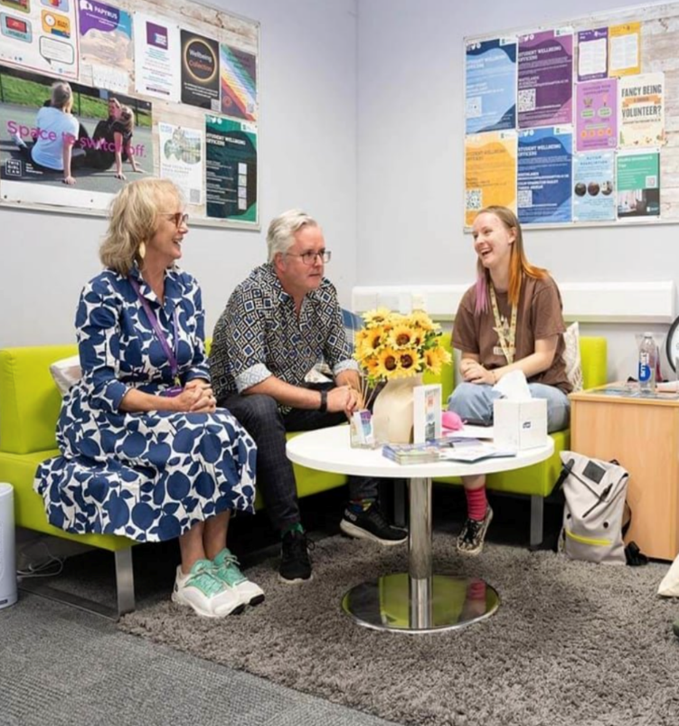
What we offer- SWO Service
A confidential service where students can discuss any issues or concerns that are affecting their wellbeing.
Sign post and refer to other internal and external services that may be able to offer further support.
30-minute full appointments with their wellbeing officer
15-minute Quick Query appointments available 48h in advance

Slide 33

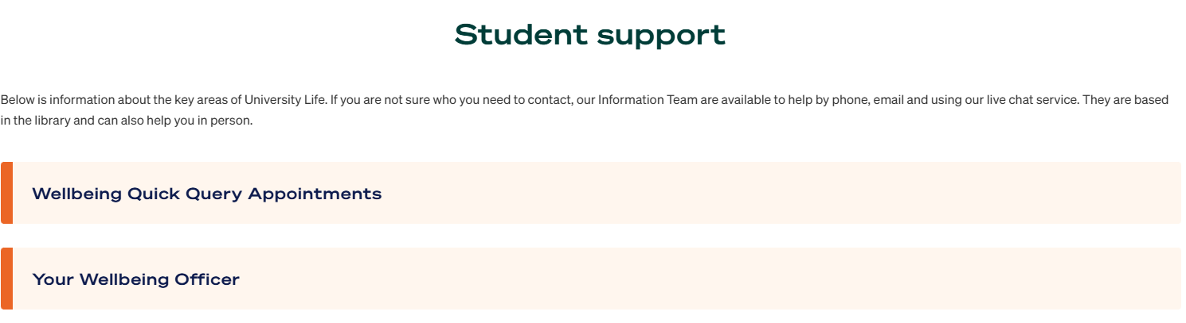

Your Student Wellbeing Officer is assigned to your campus accommodation, or (if you do not live on campus) the College in which you study
Digby Stuart
DigbyWellbeing@roehampton.ac.uk
Froebel
FroebelWellbeing@roehampton.ac.uk
Southlands
SouthlandsWellbeing@roehampton.ac.uk
Whitelands
WhitelandsWellbeing@roehampton.ac.uk
Wellbeing (general enquiries)
Wellbeing@roehampton.ac.uk
6

Slide 34

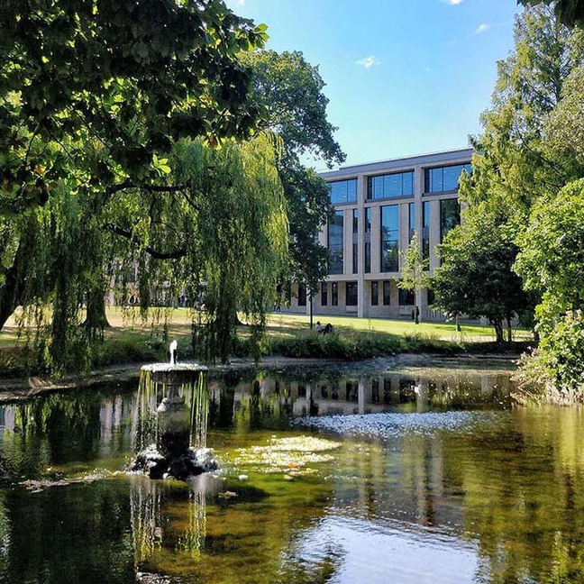

Additional Wellbeing Support
Our Counselling Service
Free access to Solution-Focused Counselling Sessions or Short-Term Counselling of up to 6 sessions.
In person or online
Mental Health Advisers
Experts on Mental Health issues who provide a short-term service, usually offering between 3-6 sessions, but may deviate on a case-by-case basis.

Slide 35

Sexual Violence Liaison Officers Service
Sexual Violence Liaison Officers (SVLOs) are qualified specialist staff who provide support to students who have experienced sexual violence at any time in their lives.
How can I access this support?
Book to speak with an SVLO here for a one-hour confidential chat.
If you have a question, you can also contact the team by email at SVLO@roehampton.ac.uk
What happens after contacting the SVLO service?
An SVLO will contact students with some questions to establish how they can best support but will not ask the student to describe what has happened in detail, and there is no obligation to engage in continued support.
Sexual Misconduct - Report + Support - University of Roehampton

Slide 36


Slide 37



The NHS Student Medical Centre is the on-campus doctor practice for students of Roehampton University.
  You do not have to live on campus to register with them.
  Registration is free and online
  You must be registered with a UK doctor (GP) to access most health and mental health services (internal and external).
Froebel College at Old Court
Open 9.30am to 5.00pm Monday to Friday during term-time.
During Spring, Winter Holiday and Summer breaks, patients are seen at Putneymead Group Medical Practice in Putney.
020 8788 0686 (Out-Of-Hours: Call 111)

Slide 38

And finally, in addition to the support available at the University of Roehampton, we signpost to external services
Talking Therapies
Wellbeing Mentoring
Talk Wandsworth
Dose of Nature
www.doseofnature.org.uk/
0203 513 6264
Online
Student Community
Drug & Alcohol Service
Listening service
www.wcdas.com
Samaritans
thestudentroom.co.uk
116 123
24/7 phone line
020 3228 1777

Slide 39

Digby Stuart
DigbyWellbeing@roehampton.ac.uk
Froebel
FroebelWellbeing@roehampton.ac.uk
Southlands
SouthlandsWellbeing@roehampton.ac.uk
Whitelands
WhitelandsWellbeing@roehampton.ac.uk
Sexual Violence Liaison Officers
SVLO@roehampton.ac.uk
Wellbeing (general enquiries)
Wellbeing@roehampton.ac.uk

Slide 40
Health & Wellbeing
Contact us on:
SWOWhitelands@roehampton.ac.uk
For out of hours support on campus contact security and ask for a warden: 020 8392 3333

Slide 41
Chaplaincy

Slide 42
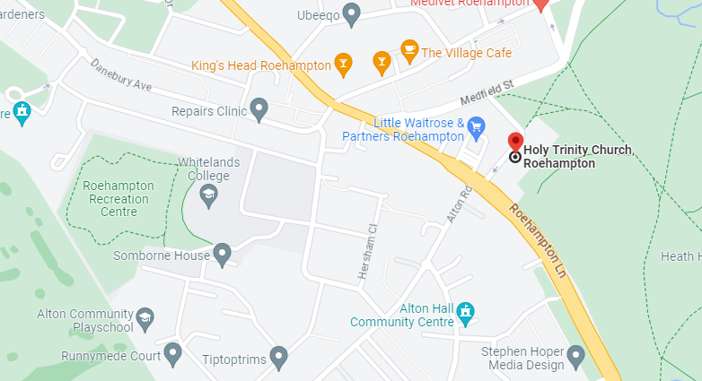

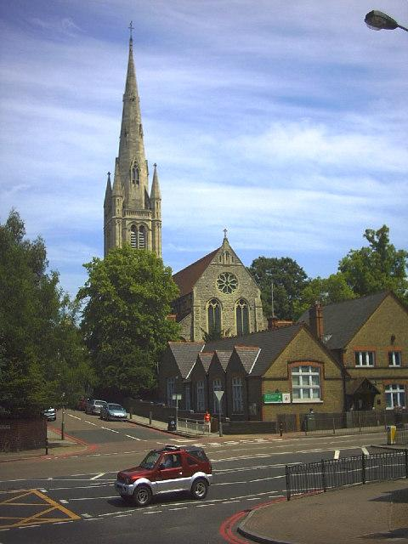

Slide 43
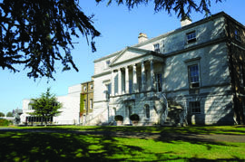
Whitelands: Reciprocal love
Behaviour on campus
  Noise / conduct
  Drugs / alcohol
  Fire Safety
  Personal safety (especially in London)
Being accountable
  Behaviours have consequences!
Support available to you
Security (Emergency: 3333, Non-emergency 3140)
Residential Community Leader
College Wardens (via Security)
Student Wellbeing Officer
Senior College Wardens
Allergy information online
PEEPs
Roe Wellbeing App
IF YOU SEE SOMETHING
REPORT IT ASAP

Slide 44
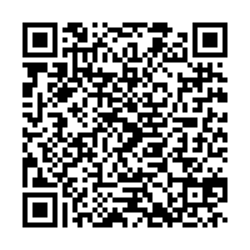
Code of Conduct
Not behave in any way which may be considered threatening or disruptive, or being likely to lead to injury or physical or emotional harm to any of its students or staff;
Not intentionally damage or deface any University, College or Student Union building or other property;
Act within the law and not engage in any activity or behaviour likely to bring the University into disrepute.

Slide 45
Fire, health and Safety eLearning
Must be completed by all students
Check your emails for a link from “BeOnline – Mail@awaken-be.com
If you have lost or deleted this email you can log in at https://Roehampton.awaken-be.com/

Slide 46
A students college support team
Head of College (HoC)
Student Leadership Manager
College Chaplain
Student Wellbeing Officer (SWO)
Senior College Warden
Student Elected Officers
Block Leader
College Warden

Slide 47
How to keep up to date on all matters Whitelands!

Slide 48
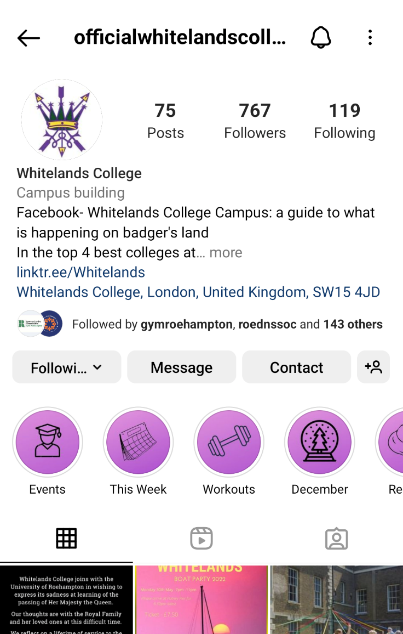
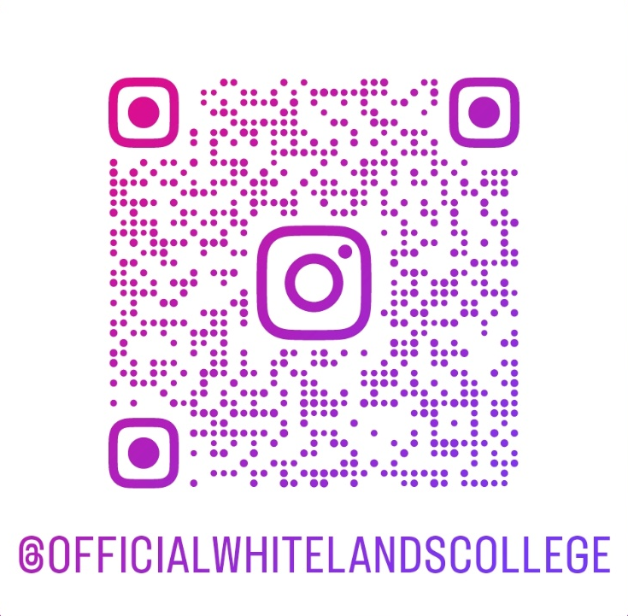
Whitelands College Instagram
Aside from your Residential Block Leaders, best way to know about Whitelands College news and activities
@officialwhitelandscollege

Slide 49
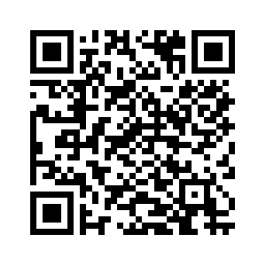

www.roehampton.ac.uk/colleges/whitelands-college
Our College Website

Slide 50

College Handbook

Slide 51
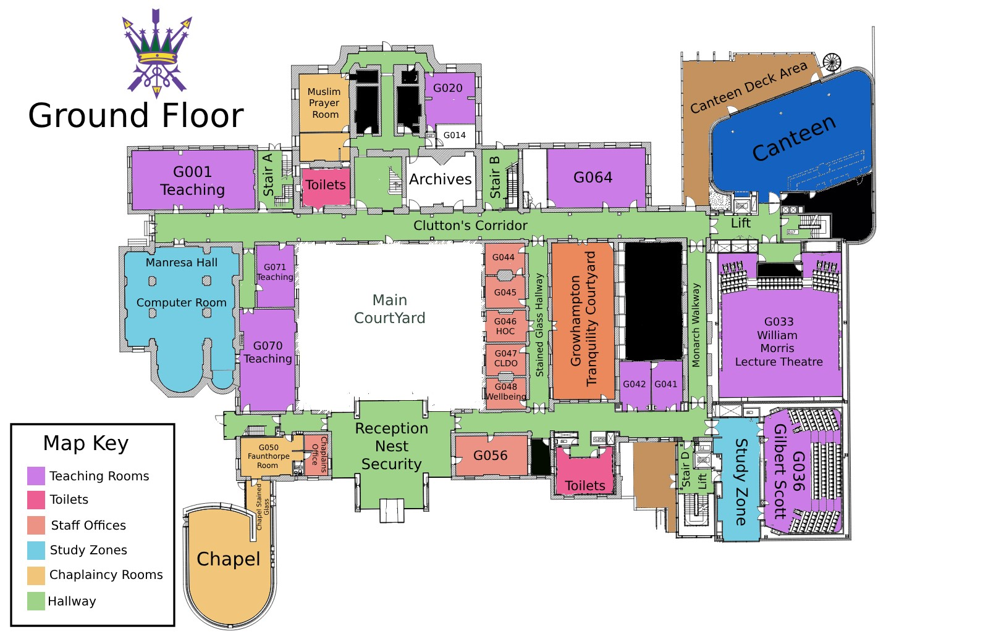
Whitelands Floor Plans

Slide 52
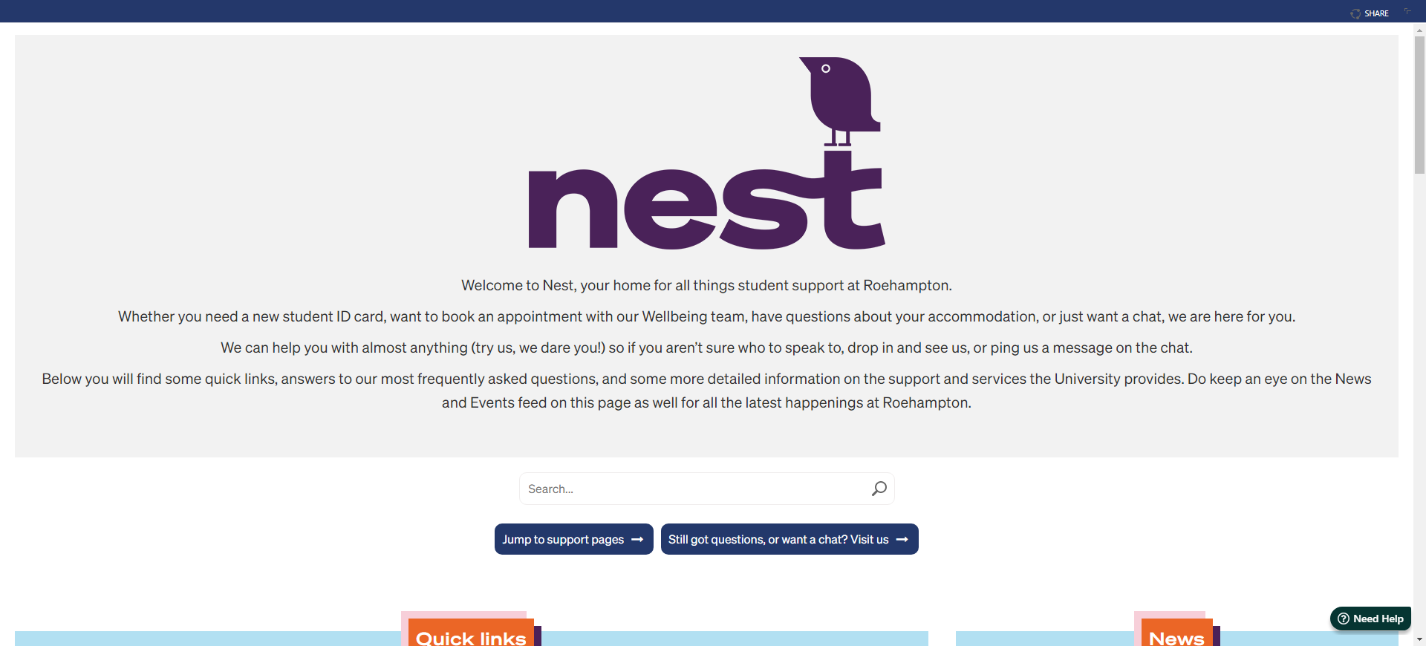
All information can be found on the Nest

Slide 53
Post and what address to use
YOUR NAME/WCPS
ROEHAMPTON UNIVERSITY
ROOM & BLOCK (I.E Durham, floor 4, room B = D4B)
WHITELANDS COLLEGE
HOLYBOURNE AVE
SW15 4JD

Slide 54


Student Apps

Slide 55
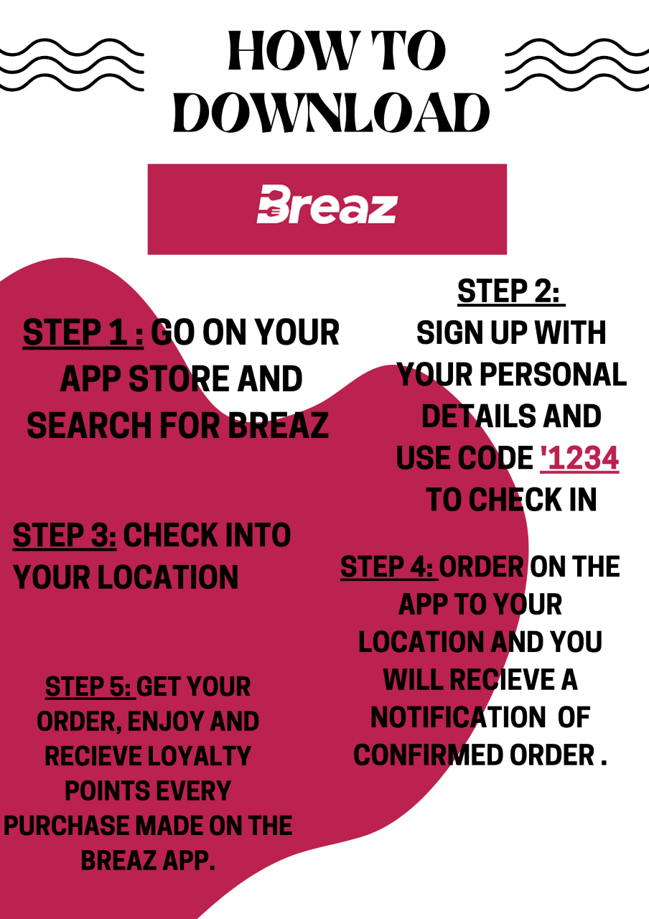
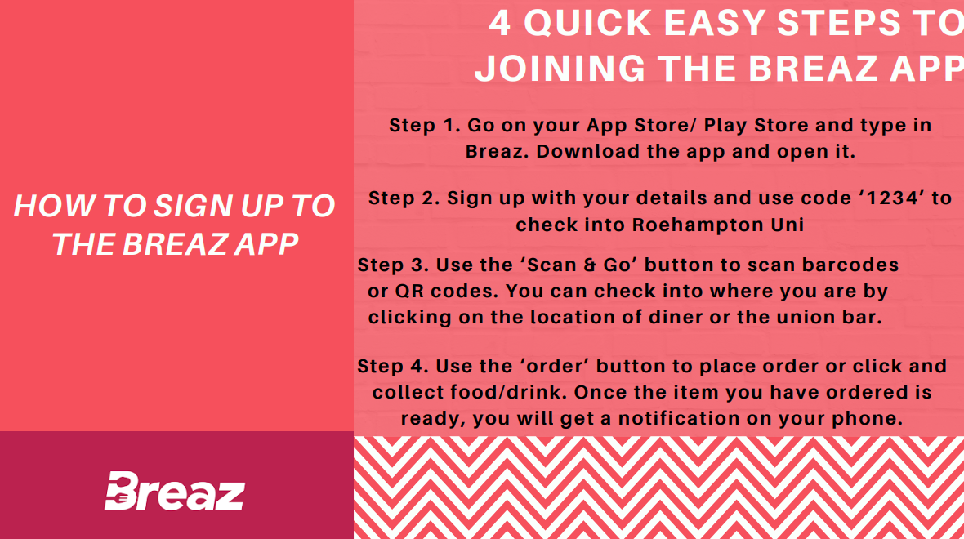
Breaz

Slide 56

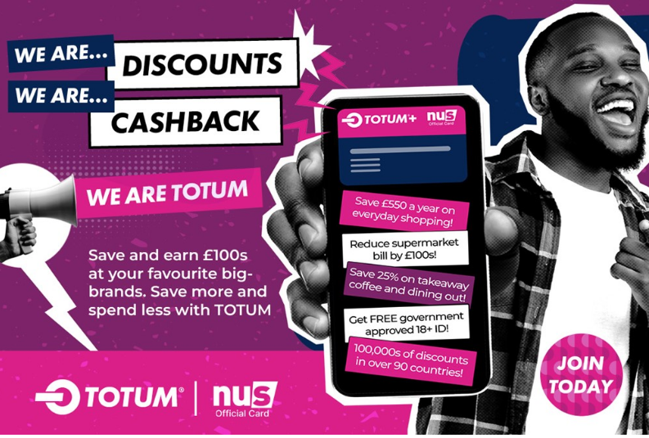

Stretch Your Cash
Totum

Slide 57
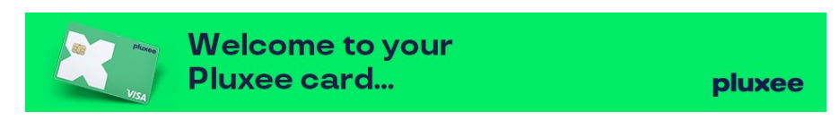
Pluxee UK Card
Earn Cashback on almost all store purchases
Asda : 2.5%
John Lewis: 5%
Waterstones: 8%
Primark: 7%
Boots: 6%
Typical Spend in Sainsburys per week - £30.00+
Cashback at 3.5%
Cashback earned per week= £1.05
Monthly cashback earnings = £4.20

Slide 58
Student Leaders Announcements

Slide 59
It is not practise that makes you perfect,
It is mistakes we learn from that make perfect

Slide 60

Haste makes Waste
You are here for 3+ years, take your time and grow at your own pace, and when you need us, we will be here, because……

Slide 61


Slide 62

Welcome to Whitelands College

