Slide 1
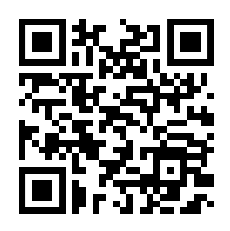
Whilst you wait, register by using this google form, thank you!

Slide 2


Welcome
Congratulations
Our ethos – Respectful, Reflective, Resilient and Resourceful.
Today and next week

Slide 3
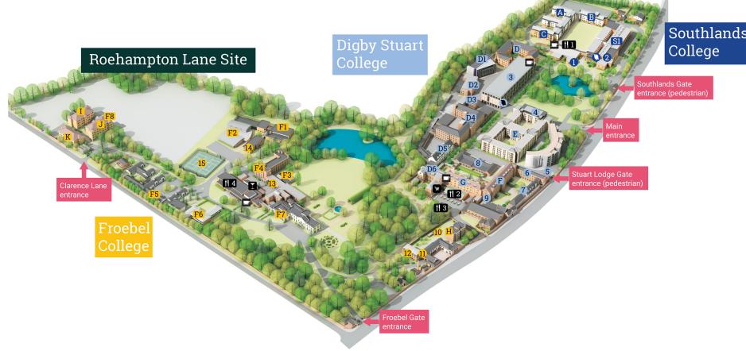
Who are we?
Matt Sossick - Deputy Dean & Head of ITE
Ruth Seabrook – Head of Secondary ITE
Steve Abrams – Head of Professional Studies
Miles Berry – Head of Curriculum and Recruitment
Sonia Cordones – Head of Partnership
Thomas Pike – Programme Leader
(Offices in the Gilroy/ Froebel buildings)
Tamara Buchan – Programme Administrator
Schools Partnership Office – deals with placements, Abyasa, mentor training, quality assurance.
(Offices in (Lower) Lawrence building)

Slide 4



Enrolment
https://www.roehampton.ac.uk/study/academic-areas/education/pgce-offer-holder-page/pgce-secondary/

Slide 5
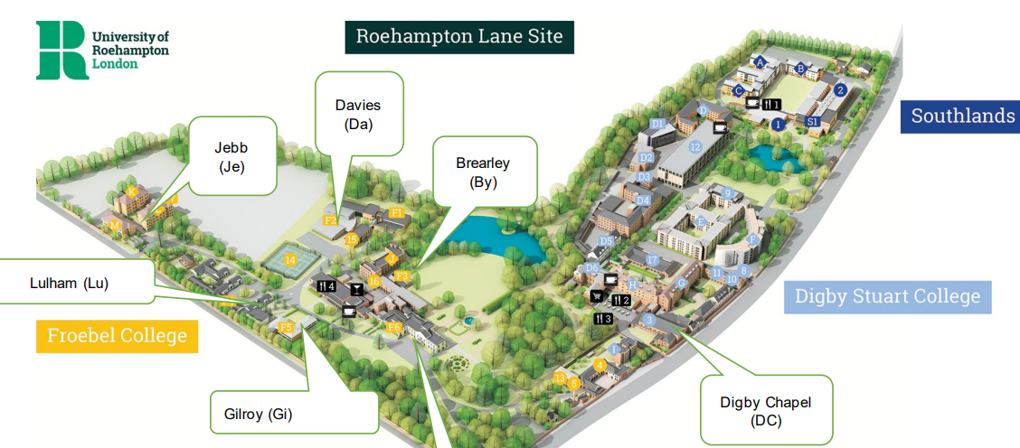
Enrolment
Library:
Exam certificates
Photo ID
DBS certificate

Slide 6
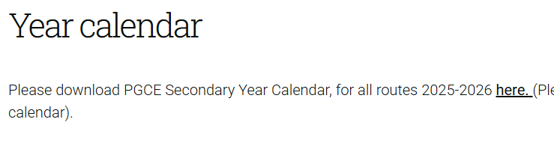
Enrolment
https://www.roehampton.ac.uk/study/academic-areas/education/pgce-offer-holder-page/pgce-secondary/

Slide 7
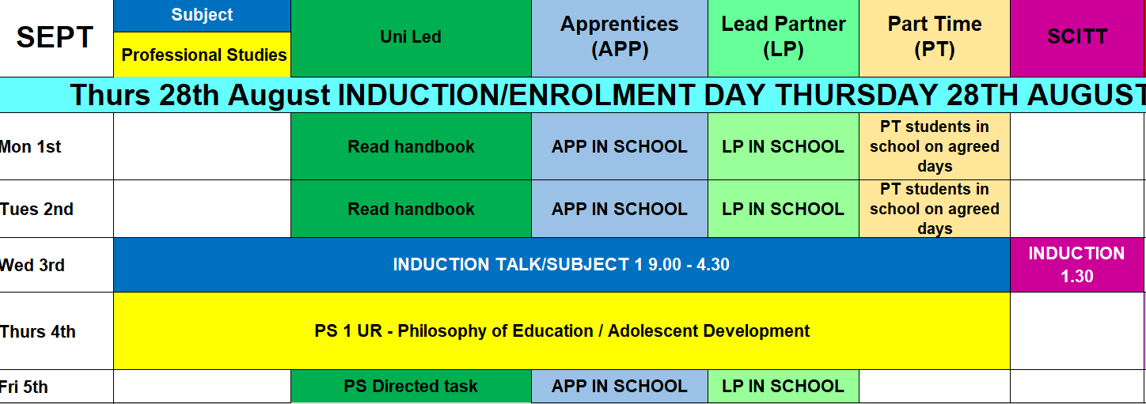
PS = professional studies
UR = University of Roehampton (campus)
Hubs – hub school where you will be based on some PS days

Slide 8
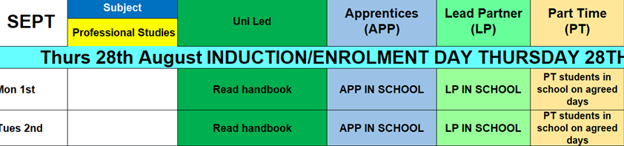
Next week
Uni-led:
Handbook and review information or tasks sent by subject tutor
You will be in school from the end of September but will be told which school by mid-September (no sooner!)
APP or LP:
- Your school will direct you in School with observations and shadowing teacher/pupils.
- Handbook and review information or tasks sent by subject tutor

Slide 9
What else can I do?
ITT – ECF, DfE documentation supporting your training
Teaching Standards – DfE
Your subject Curriculum
Access GCSE specifications/past exam papers/ marking schemes and Exam Reports to understand exam requirements for your subject
OFSTED report from your placement school (LP only)
OFSTED subject reports series for your subject
Explore your Professional Association (website and review)
Education Endowment Foundation
Explore your section in the Library
Access and Explore the Teacher SEND Handbook 2024 published by NASEN and available online

Slide 10
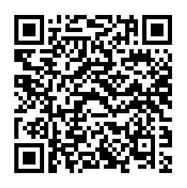

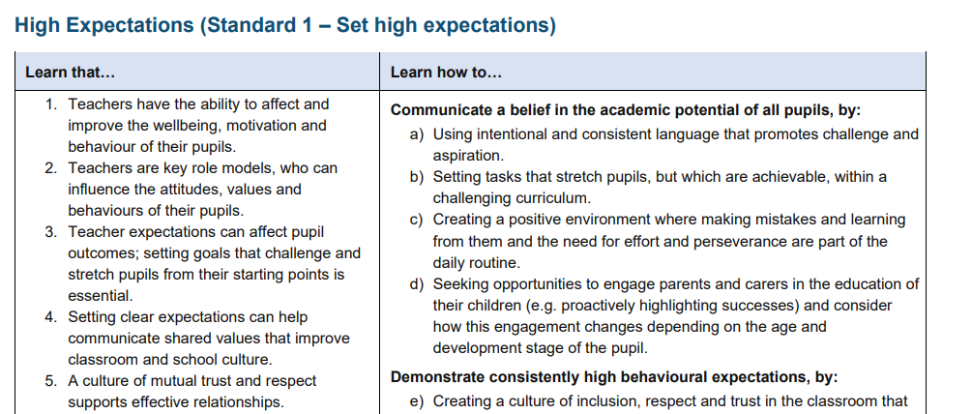
https://www.gov.uk/government/publications/initial-teacher-training-and-early-career-framework

Slide 11

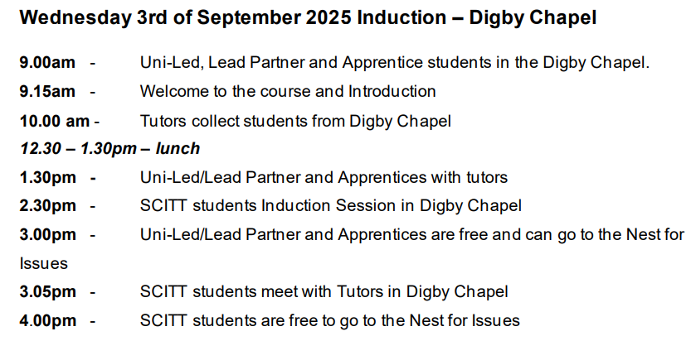
Next week
All:
Meet back here for 9am
You will then meet your tutors, who will take you to their teaching rooms

Slide 12


Next week
All:
Meet back here for 9.30am
Your PS group will be allocated as part of the day

Slide 13

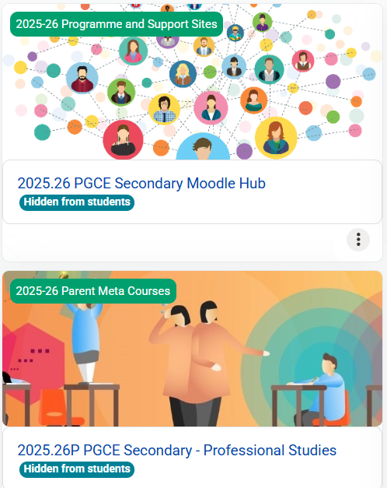
Next week
Moodle:
This is our online platform for sharing reading, tasks, communication and for the setting and submitting of assignments
You will need to join 3:
Subject moodle
Secondary moodle
PS moodle

Slide 14
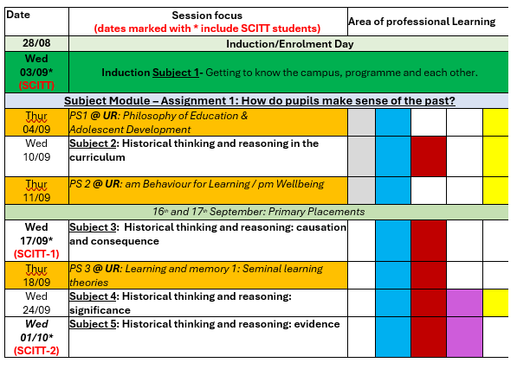

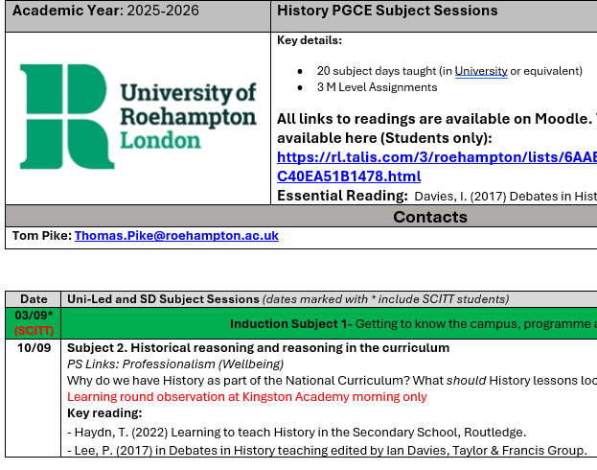
Next week
Handbooks (subject and PS):
You will either be sent these, or information as to how to access these on Moodle
They are crucial as they contain information about weekly sessions and pre-reading

Slide 15
For any issues, make sure you contact FIRST the correct department, in subject line please write your full name/student ID and Subject.
Finance: studentfinance@roehampton.ac.uk
Admissions: teachertraining@roehampton.ac.uk
Immigration: immigration@roehampton.ac.uk
DBS: DBS@roehampton.ac.uk
Disability: Disabilities@roehampton.ac.uk
Wellbeing team: Froebelwellbeing@roehampton.ac.uk
Moodle access: PGsecondary@roehampton.ac.uk
For general queries nest@roehampton.ac.uk
For any other matters please contact your subject tutor directly. DO NOT CONTACT YOUR SUBJECT TUTOR IF YOU HAVE NOT ALREADY CONTACTED ONE OF THE ABOVE FIRST

Slide 16
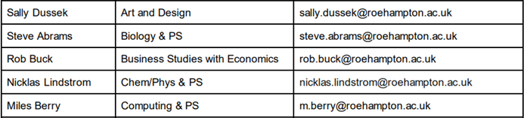
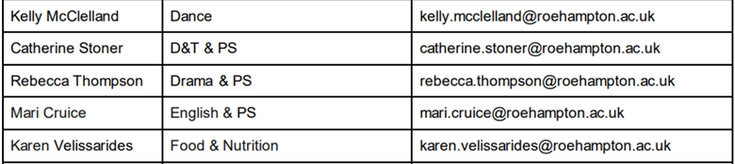
Tutors

Slide 17
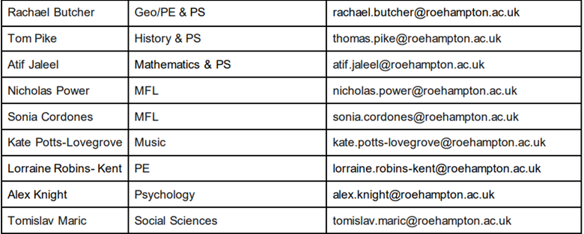
Tutors

Slide 18
Welcome
Congratulations
Our ethos – Respectful, Reflective, Resilient and Resourceful.
Good luck and please ask if you are unsure

