Slide 1
Placement Reasonable Adjustments
Placement Reasonable Adjustments Form (PRAF) is a specific resource that helps to support students that require reasonable adjustments during Block School Placement (BSE)
Self-advocacy
Complements Summary of Adjustments (SOA)
Placement Toolkit
Notes:
What is it?

Slide 2
PRAF – the process
students start to discuss reasonable adjustments for placement with Disabilities
discussion with Group Tutor about required adjustments
discussion with Placement school
opportunity for review

Slide 3
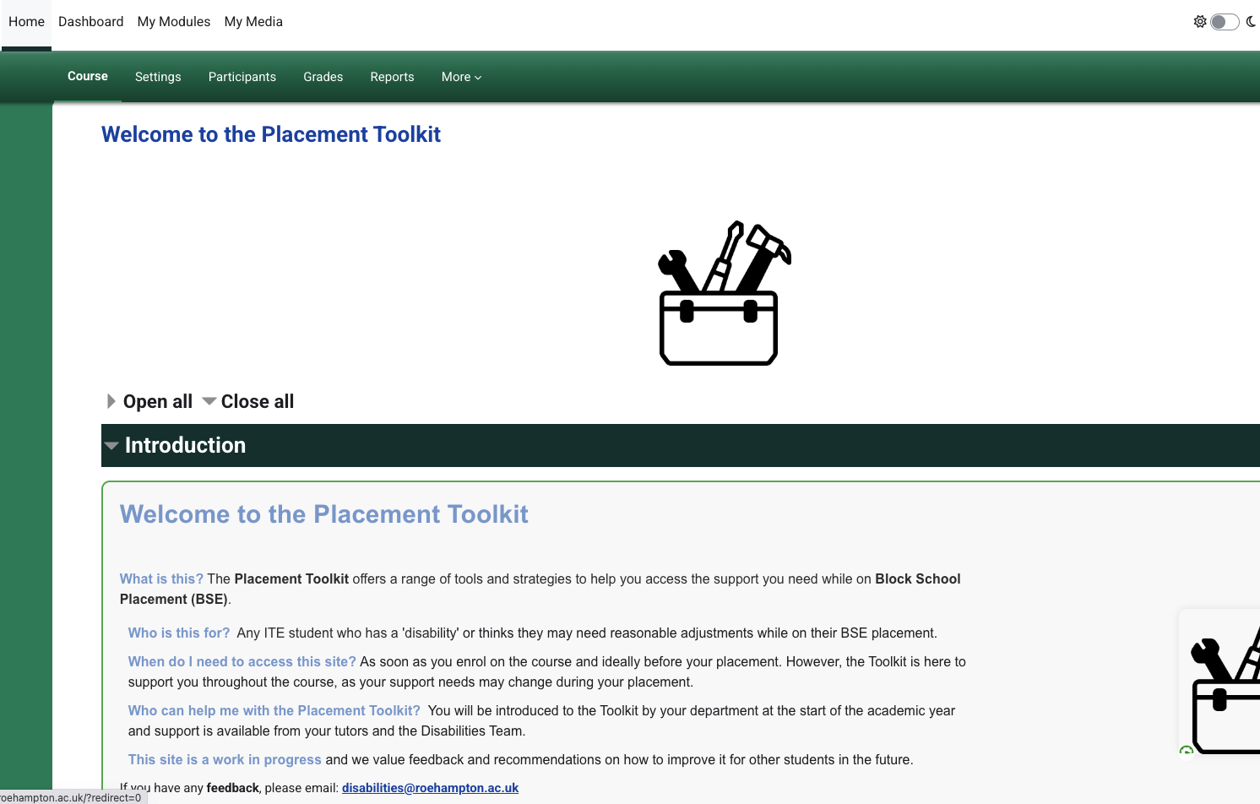

Slide 4


Lynda Chinaka
Disabilities Co-ordinator
Senior Lecturer in Computing in Education
Disabilities Coordinator for ITE
Lulham Building LU.14
School of Education/Froebel College
University of Roehampton|London|SW15 5PJ
Lynda.Chinaka@roehampton.ac.uk

