Slide 1

An Introduction to Professional Studies

Slide 2
What is Professional Studies?
Area of Professional Learning (APL) |  | ITTECF
Professional Behaviours | Having high expectations of self and pupils Developing an awareness of the context of schools Local and national policies and priorities and their impact on practice Working with other adults – support assistants and parents Critical, research and practice informed reflection | St.1 St.8
Behaviour | Promoting positive behaviour for learning Understanding challenging behaviour | St.1 St.7
Pedagogy | Psychology and neuroscience in learning Child development Theories of learning Assess->plan->do-> review cycle Adapting teaching to secure learning for all – SEND, EAL, Global Majority | St.2 St.4 St.5
Assessment | Understanding formative and summative assessment | St.6
Curriculum | EYFS / National Curriculum | St.3

Slide 3
Developing Critical Practice
How many children, on average, are excluded from school each day?
How many children each day lose learning due to suspension from school
A child in receipt of free school meals is how many times more likely to be excluded than a child who is not?
What percentage of children permanently excluded from primary school have a special educational need or disability?
Which minority ethnic group has the highest rate of permanent exclusion?

Slide 4
Developing Critical Practice
How many children, on average, are excluded from school each day?
How many children each day lose learning due to suspension from school
A child in receipt of free school meals is how many times more likely to be excluded than a child who is not?
What percentage of children permanently excluded from primary school have a special educational need or disability?
Which minority ethnic group has the highest rate of permanent exclusion?
57 (DfE, 2026)
5,026 (DfE, 2026)
Five times (DfE, 2026)
88% (DfE, 2026) 96.6 % (FFT Datalab, 2025)
Gypsy/Roma (DfE, 2026)

Slide 5
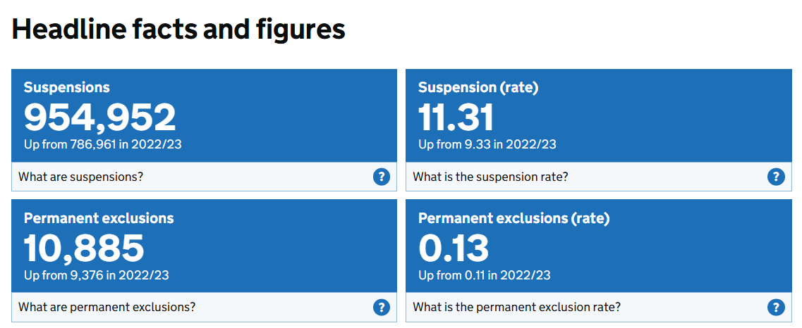
Developing critical practice

Slide 6
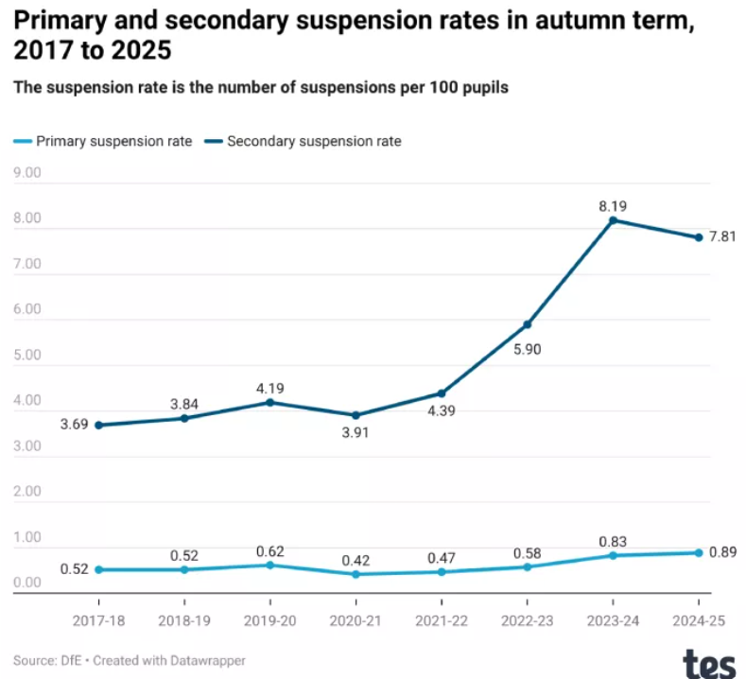
Developing critical practice

Slide 7
Developing critical practice
Sex - Male pupils also had a higher permanent exclusion rate of 0.05 (5 in every 10,000), which is more than twice that of female pupils, who had a rate of 0.02 (2 in every 10,000).
FSM - The suspension rate for pupils eligible for FSM was more than four times that of pupils who were not eligible. Permanent exclusion rates were also higher for FSM-eligible pupils, with a rate of 0.10 compared to 0.02 for pupils who were not eligible. All figures increased from the 24/25 data.
SEN - The suspension rate for pupils with an EHC plan increased to 8.83, lower than for those with SEN support at 9.79. The rate for pupils with no identified SEN was almost four times lower. The rate of permanent exclusions for pupils with an EHC plan increased and was almost five times higher than for those without SEND.
Ethnicity - Gypsy/Roma pupils continued to have both the highest suspension and exclusion rates in spring term 2023/24, at 13.86 and 0.12 respectively. Traveller of Irish Heritage pupils had the second highest rates of suspensions (10.11). Traveller of Irish Heritage pupils together with Mixed White and Black Caribbean pupils had the second highest rate of permanent exclusions.

Slide 8
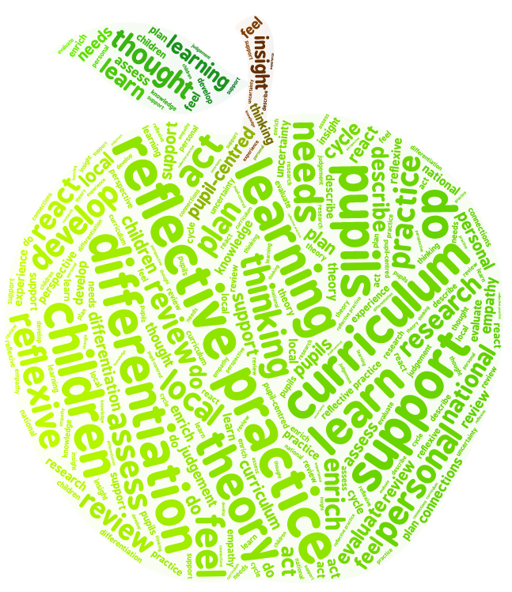
Reflective Practice
‘My opinions, values and teaching approaches have developed as a consequence of the module.’
‘I have really valued the opportunity to reflect on my own and other students’ experiences and practice.’
‘I have been challenged to think critically.’
‘PS has supported me well for the realities of the classroom.’

Slide 9

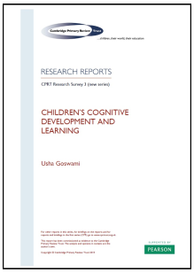

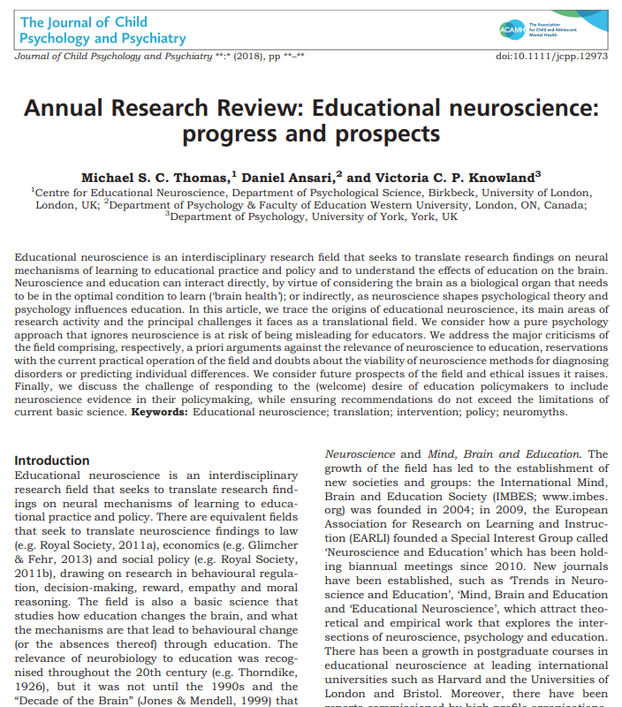

Understanding learning

Slide 10
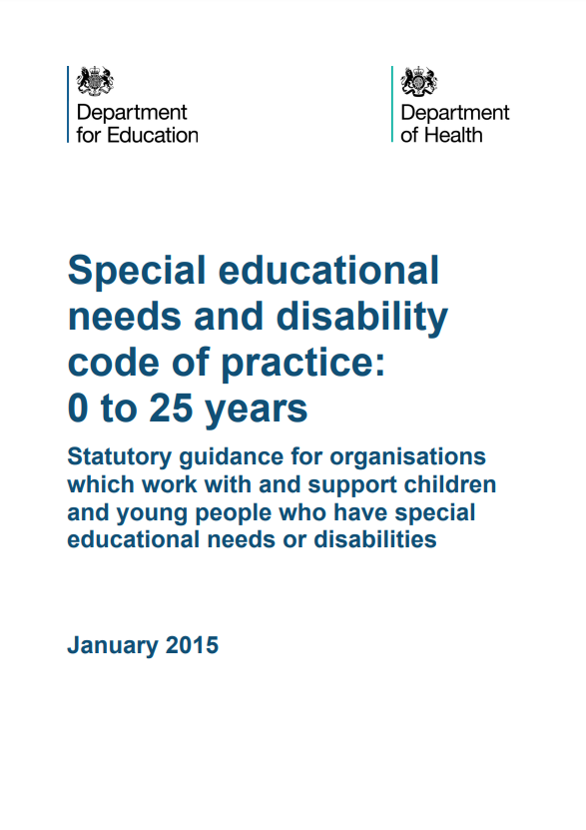
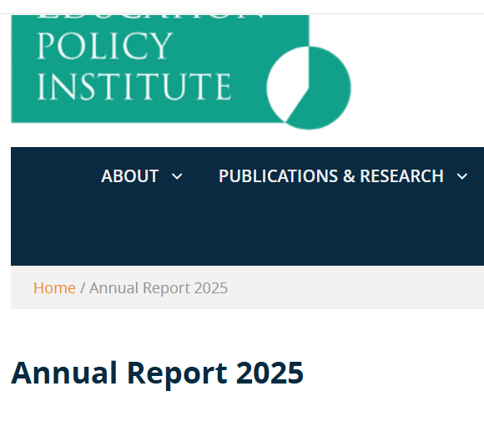
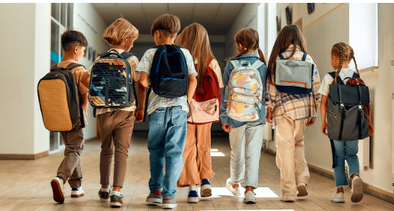
Understanding policy, context and professional requirements

Slide 11
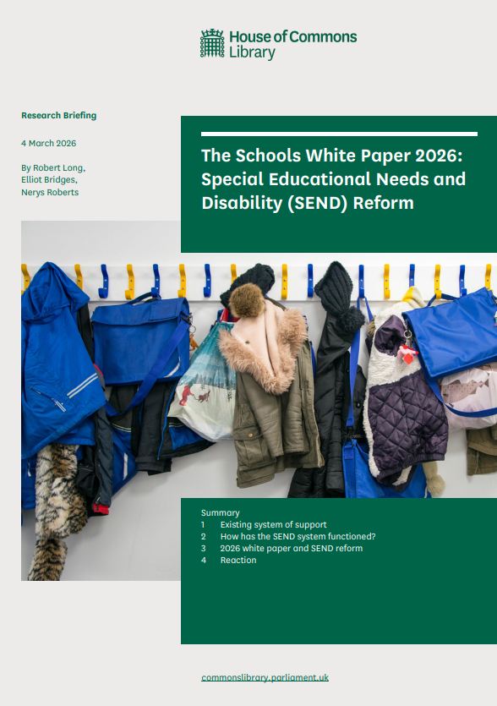

Understanding policy, context and professional requirements

Slide 12
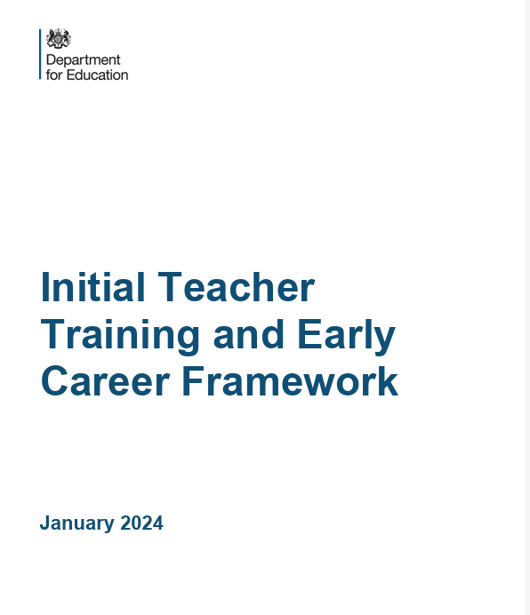
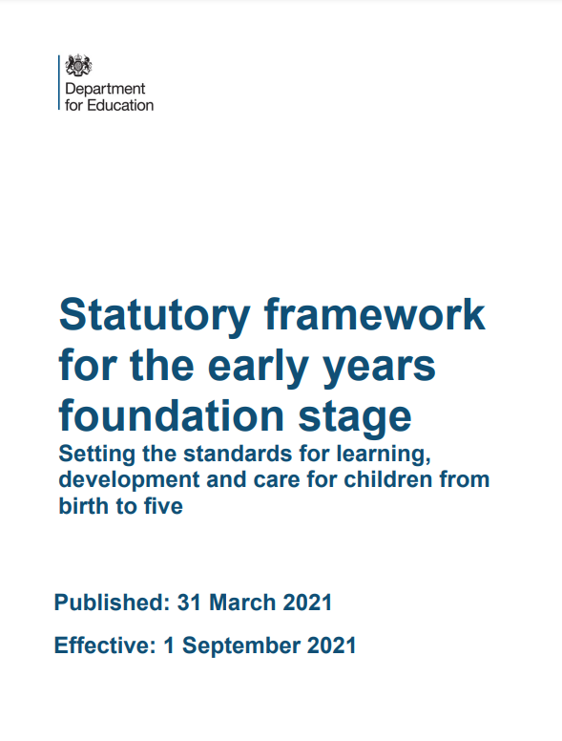
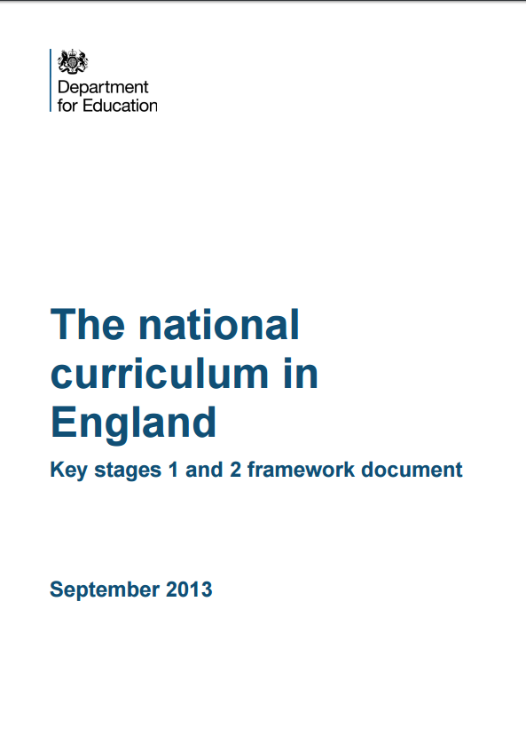
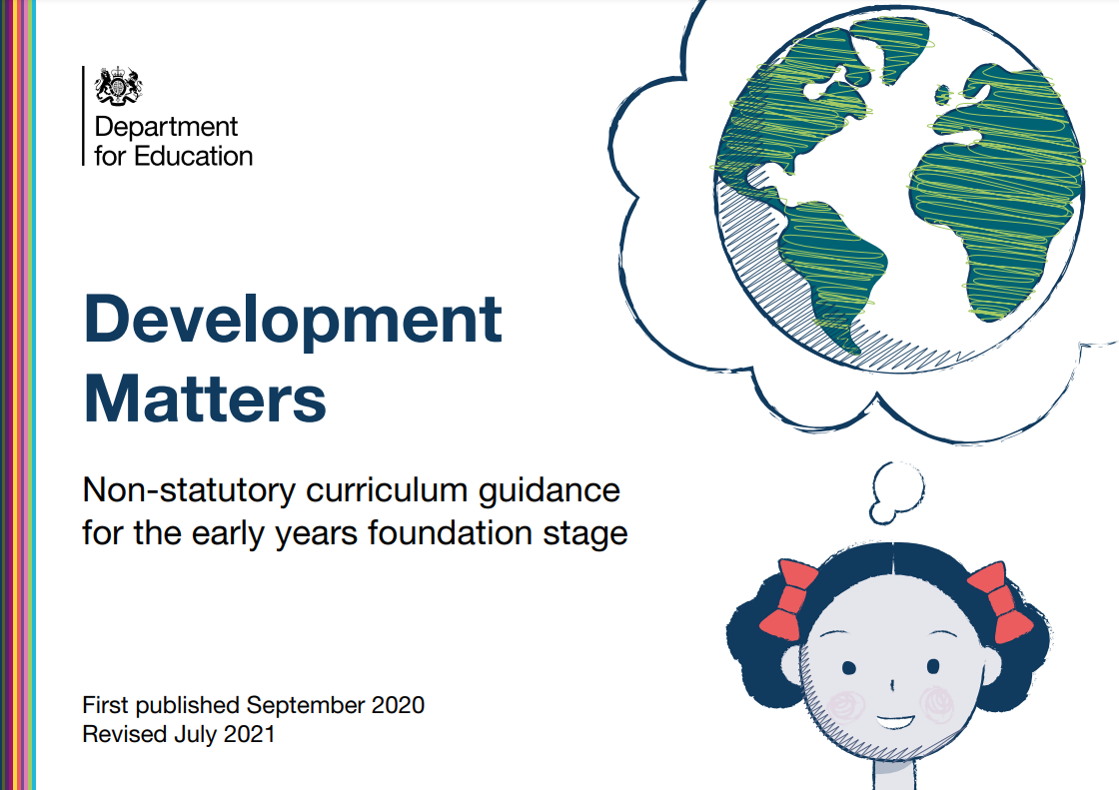
Understanding the curriculum
Your curriculum
The Early Years Curriculum and National Curriculum

Slide 13
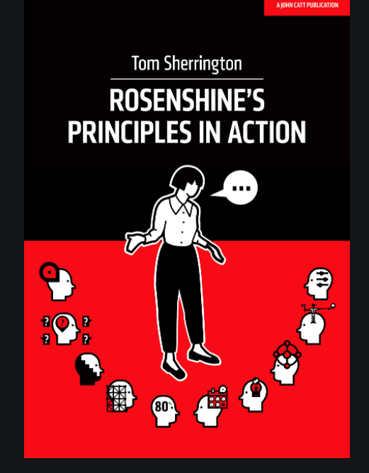
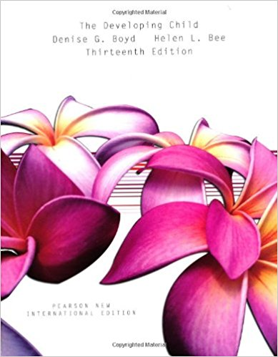
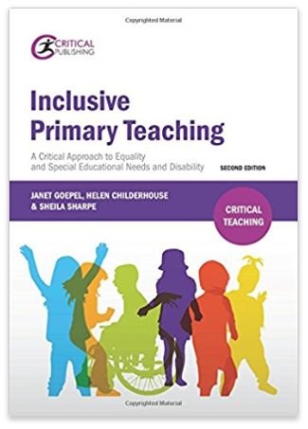
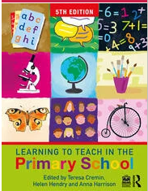
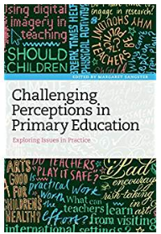

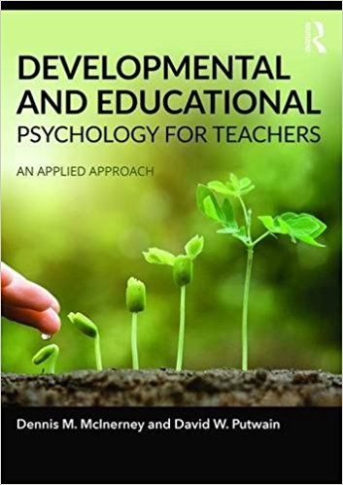
Sherrington, T. (2019). Rosenshine’s Principles in Action. Woodbridge: John Catt Educational Ltd.
Boyd, D. and Bee, H. (2014) The Developing Child. (13th edition) Essex: Pearson.
Cremin, T., Hendry, H. and Harrison, A. (2025) Learning to teach in the primary school (5th edition) Oxford: Routledge
Goepel, J., Childerhouse, H. and Sharpe, S. (2015). Inclusive Primary Teaching: a critical approach to equality and special educational needs (2nd edition). Northwich: Critical Publishing
Moyles, J., Georgeson, J., and Payler, J. (2017) Beginning Teaching, Beginning Learning In Early Years and Primary Education (4th edition) Maidenhead: Open University Press pp. 94-106.
McInerney, D. and Putwain, D. (2017) Developmental and Educational Psychology for Teachers: An Applied Approach. (2nd edition) Oxford: Routledge.
Sangster, M. (ed.) (2017) Challenging Perceptions in Primary Education: Exploring Issues in Practice (1st edition) London: Bloomsbury Academic

