Slide 1


Introduction to English
Steph Laird
s.laird@roehampton.ac.uk
Notes:
Welcome to the English module. This session will give you an overview of how you can prepare for the programme and guidance in terms of expectations of teaching English in school placements. You will either be taught by me or my colleague Anna on the English module of the programme.

Slide 2
Du Iz Tak?
Notes:
Probably wonder why I am showing you a sentence that is clearly not English. First of all, how do we know it is a sentence (?) and what do you think it means? Any idea of the language.
What we are doing is trying to make meaning when we read text whether that be written text or signs and symbols in our environment. The point of the English curriculum is to support children in making, understanding and communicating meaning whether that be through spoken communication or written text.

Slide 3
What is being said?
Notes:
I have included the illustration which does come from a front cover of a children’s book. Does this now support you in making meaning? What I am showing you now is a multi-modal text, where meaning is communicated via two modalities – text and illustration. Whilst this can support meaning making, in terms of early reading and children’s ability to apply phonics strategies, this is not a recommended approach. Therefore we make the distinction between reading for pleasure texts and choosing texts that are appropriate for practising key phonics approaches.

Slide 4
Elements of Language
Sound
Word
Sentence
Notes:
Therefore in order to make meaning, there are three main things happening. We need to know the sound system of a language, how those sounds (phonemes) are blended together in order to make words and then how these are ordered in sentence to make sense.

Slide 5
Elements of Language
MEANING
(semantics)
https://www.youtube.com/watch?v=81CxsmxWvO4
Notes:
The goal is obviously meaning making – aka semantics. There will be terms introduced on the programme which may be new to you and which may also feature in the national curriculum and EYFS profile. The way English is being taught now in the classroom is obviously based upon the requirements of the NC and EYFS profile and may differ to your own school experiences.

Slide 6
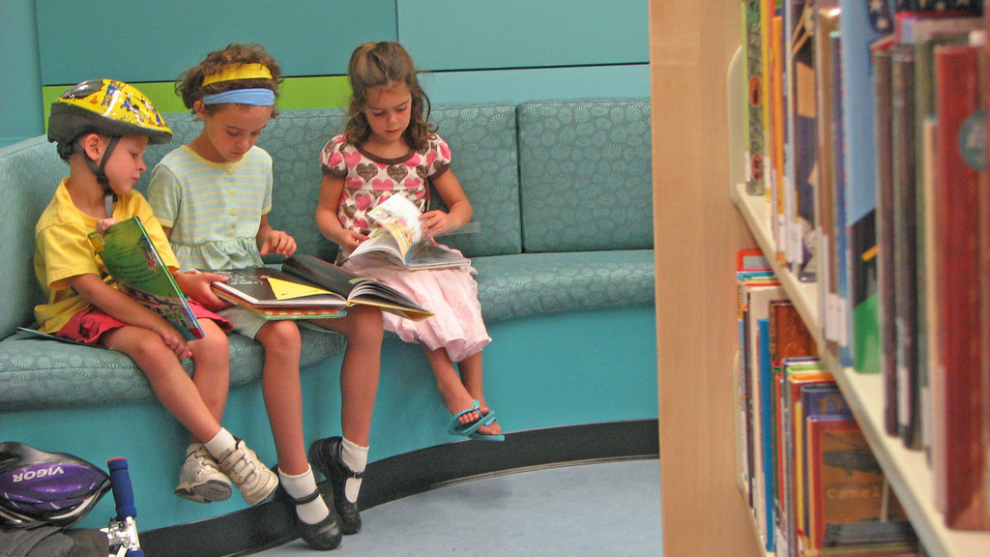
What is English?
What are your memories of English lessons in primary school?
‘English has a pre-eminent place in education and in society. A high-quality education in English will teach pupils to speak and write fluently so that they can communicate their ideas and emotions to others and through their reading and listening, others can communicate with them. Through reading in particular, pupils have a chance to develop culturally, emotionally, intellectually, socially and spiritually. Literature, especially, plays a key role in such development. Reading also enables pupils both to acquire knowledge and to build on what they already know. All the skills of language are essential to participating fully as a member of society; pupils, therefore, who do not learn to speak, read and write fluently and confidently are effectively disenfranchised.’
The national curriculum (2014) Purpose of Study English – key stages 1 and 2
This Photo by Unknown Author is licensed under CC BY-SA
Notes:
Talk with partners about their own memories of English lessons in primary school. Share own. Point out quote from the NC which illustrates the necessity for speaking, reading and writing fluently to empower children.

Slide 7


Familiarise yourself with documentation
https://www.gov.uk/government/publications/early-years-foundation-stage-framework--2
https://www.gov.uk/government/publications/national-curriculum-in-england-primary-curriculum
Notes:
Those requirements are further broken down in the policy documentation on a school’s curriculum should be based. In terms of preparation for the programme, you will need to download and start to become familiar with these documents – the EYFS profile is for children in nursery and reception and the NC for years 1-6. In the pre-course booklet we recommend starting to look at these documents now, not just for English, as during the programme you will be tracking your own subject knowledge against these documents so we recommend reading these in advance.

Slide 8
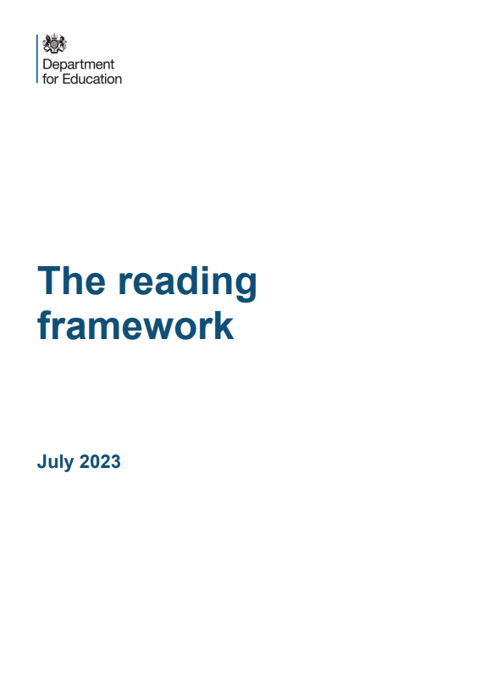
Early reading and ssp
Phonic knowledge
In order to teach reading effectively you will need to develop your subject knowledge about systematic synthetic phonics.
In order to prepare yourself for this important strand of subject knowledge:
Look up the following terms and make notes about them: systematic synthetic phonics, phoneme, grapheme, digraph, trigraph, adjacent consonants, blend, segment.
Understanding how early reading is taught is an important aspect of the course. Read The Reading Framework (DFE, 2023):
https://www.gov.uk/government/publications/the-reading-framework-teaching-the-foundations-of-literacy
Notes:
Understanding how to teach phonics may be new for some people so we do recommend referring to the reading framework and becoming familiar with the key terminology as listed in the pre-course booklet. Everyone – no matter age phase of placements – will need to understand how to teach phonics and early reading which is part of the TS. May also find you are teaching beginner readers of older age phases and intervention in reading may be needed.

Slide 9
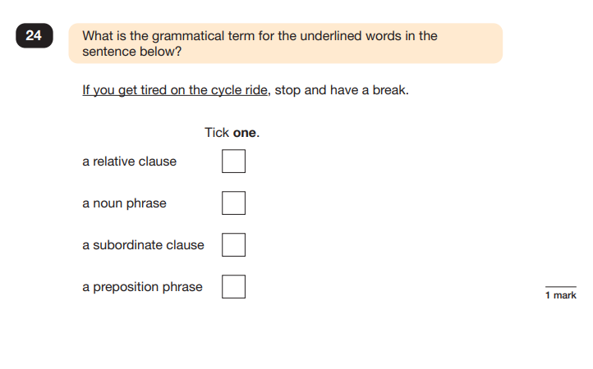
spaG – brush up on your grammar knowledge
Difference between phrase and clause – a clause includes a subject and a verb.
‘You’ and ‘get’ are subject and verb so cannot be a phrase.
A relative clause always starts with a relative pronoun - who or which or that.
A subordinate clause is one which doesn't have complete meaning on its own and relies on the main clause for its meaning. Therefore, this is a subordinate clause as the second part gives you the information required for the sentence to make sense. It starts with the subordinating conjunction ‘if’.
SPaG test 2024
Notes:
Knowledge of English grammar is a key area of teaching and also for your own subject knowledge for academic writing. There is guidance in the pre-course booklet so you may wish to look at previous year 6 SPaG tests online – often used in job interviews.
Difference between phrase and clause – a clause includes a subject and a verb.
‘You’ and ‘get’ are subject and verb so cannot be a phrase.
A relative clause always starts with a relative pronoun - who or which or that.
A subordinate clause is one which doesn't have complete meaning on its own and relies on the main clause for its meaning. Therefore, this is a subordinate clause as the second part gives you the information required for the sentence to make sense. It starts with the subordinating conjunction ‘if’.

Slide 10
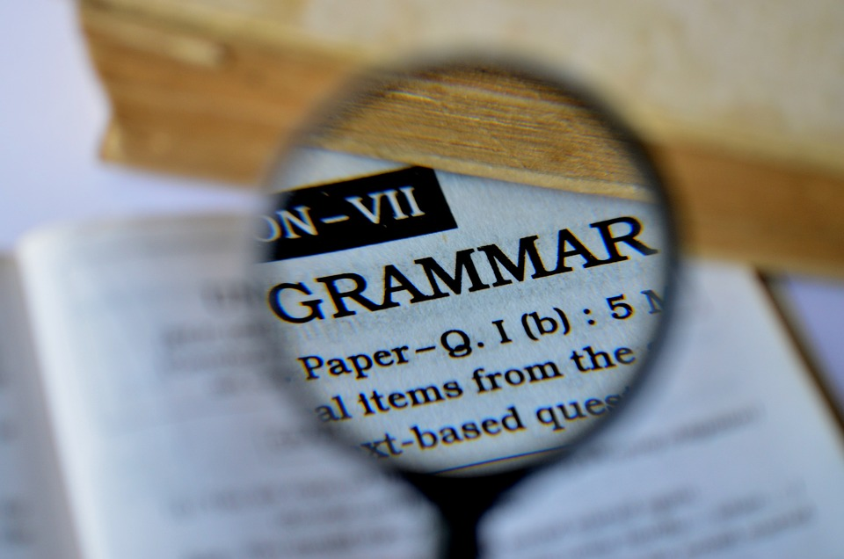
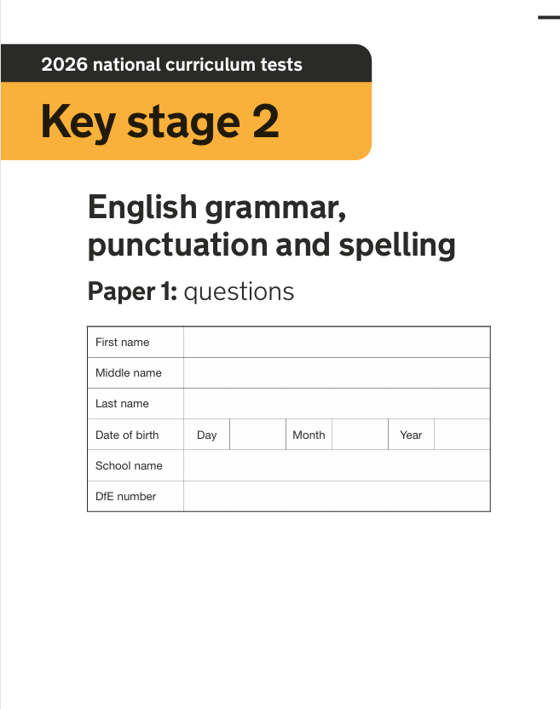
Key stage 2 tests: 2026 English grammar, punctuation and spelling test materials - GOV.UK
Notes:
Recommend undertaking a SPaG test – most recent from 2026 now online too. We will continue to track subject knowledge via online audits across the programme. Past Y6 papers all available online for practice.

Slide 11
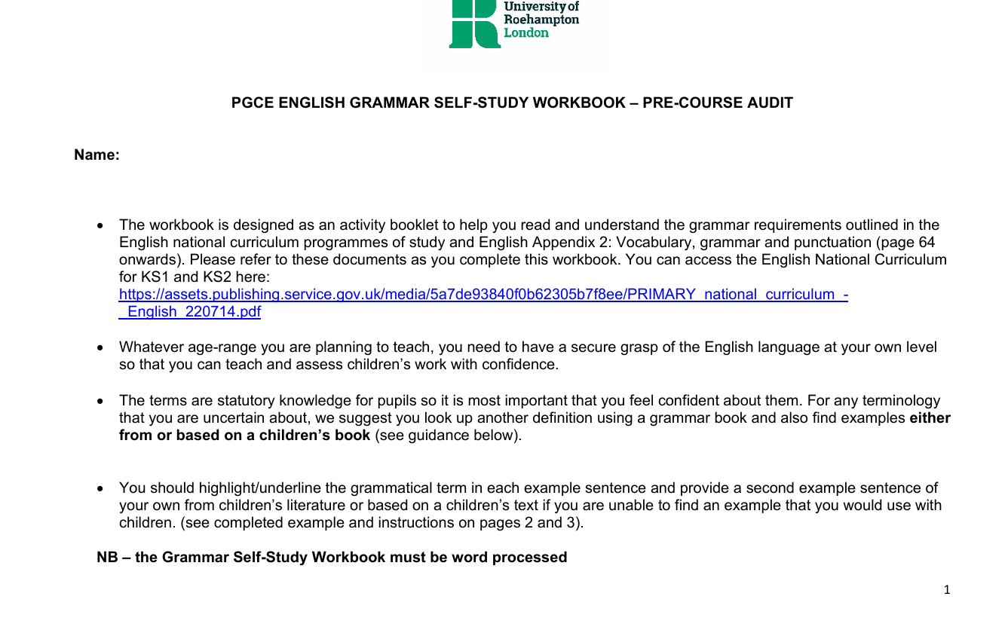
Have you completed the English grammar audit?
Notes:
Make sure this is completed. You will be asked to upload this as evidence of completion at the start of the programme. We will then refer to it in our grammar sessions but it will also be a working document to support you with the teaching of grammar in school.

Slide 12

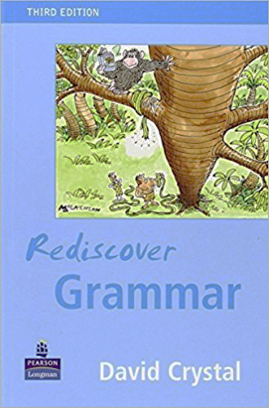
Finding resources to support your subject knowledge
Medwell, J. ad Wray, W. with Moore, G. and Griffiths, V. (2017) Primary English: Knowledge and Understanding (8th ed.). London: Sage
Crystal, D. (2004) Rediscover Grammar. London: Palgrave Longman
Notes:
Invest in a grammar book – share mine.

Slide 13
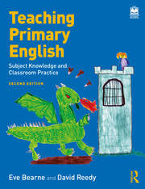
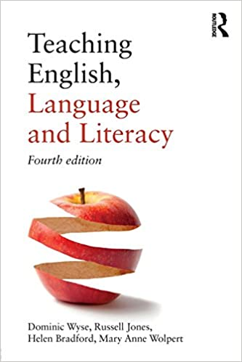
Teaching Primary English:
Subject Knowledge and Classroom Practice
Eve Bearne and David Reedy.
Routledge (2023)
Teaching English,
Language and Literacy
(4th Edn.) Dominic Wyse, Russell Jones, Helen Bradford, and Mary Anne Wolpert. Routledge (2018)
HE Level 6
HE Level 7
Both of these texts are available as eBooks
(available in September once you have enrolled)
Notes:
Core text books will be referred to for weekly course readings. These will be accessible once fully enrolled and directed to in English seminars.

Slide 14
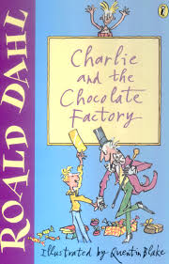

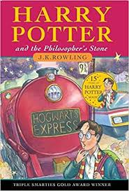



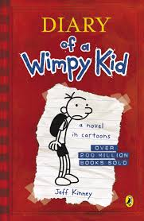
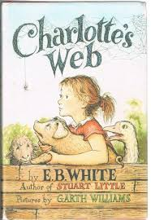


Look at the covers of these well-known children's books. Name the book title and the author.
Notes:
Look at the front covers of these well-known children’s books. Can you remember the title and author? Talk to partner. Answers on the next slide.

Slide 15
The Gruffalo’s Child
Julia Donaldson
Harry Potter and the Philosopher’s Stone
J. K. Rowling
Wind in the Willows
Kenneth Grahame
Where the Wild Things Are
Maurice Sendak
Charlie and the Chocolate Factory
Roald Dahl
Elmer
David McKee
The Cat in the Hat
Dr Seuss
Diary of a Wimpy Kid
Jeff Kinney
Charlotte’s Web
E.B. White
The Tiger who came to Tea
Judith Kerr
Notes:
These are favourite texts of many children and you may remember many of these from childhood. However, there are many more recent picture books available and it is a good idea to expand your reading of these in preparation for the course – we will introduce you to fiction, non-fiction, picture books, novels, poetry and film as texts.

Slide 16



https://www.thereaderteacher.com/
https://www.lovereading4kids.co.uk/blog/diverse-voices-childrens-books-that-celebrate-difference-6090
UKLA Book Awards Longlist 2026 - UK Literacy Association
Notes:
Impossible to provide just one list of recommended texts to read as schools will build their curriculums around texts that may address specific aims of their own curriculum. A good place to start looking at wider reading of children’s books is from the UKLA book awards which are chosen by teachers. Access the lists via link. The reader teacher website is also a useful collection of books – F/NF and poetry recommended for different year groups. Also remember diversity to be represented through texts as children need to see themselves reflection through the texts they read – look at the love reading blog.

Slide 17
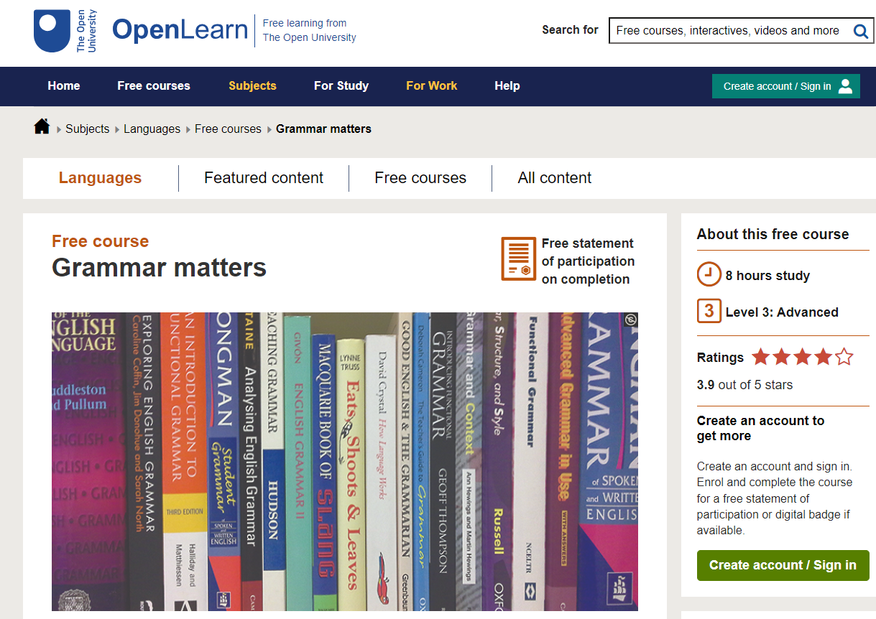

Reading for pleasure/grammar self study
https://www.open.edu/openlearn/languages/grammar-matters/content-section-0?active-tab=description-tab
https://ourfp.org/
Notes:
OU offers online free course in grammar and reading for pleasure if these are areas for development.

Slide 18
Preparation for English – refer to the pre-course booklet
Download and complete the grammar self-study audit
Enjoy reading and researching children’s books over the summer

