Slide 1

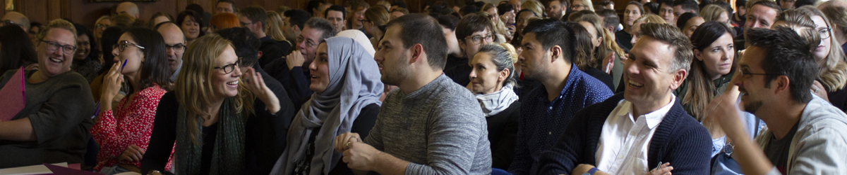
Ruth Seabrook Head of Secondary ITE
Ruth.Seabrook@Roehampton.ac.uk
Sonia Cordones PGCE Programme Lead
Sonia.Cordones@Roehampton.ac.uk
WELCOME

Slide 2
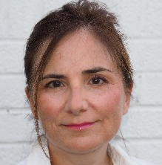
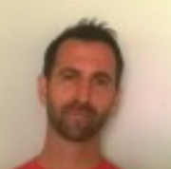

Who are we?
Ruth Seabrook – Head of Secondary ITE Ruth.Seabrook@roehampton.ac.uk
Sonia Cordones – Programme Leader
Steve Abrams– Head of Professional Studies – & Science
Tamara Bucan – Programme Administrator
Subject Tutors – see over

Slide 3
Subject Leads:
SUBJECT SUBJECT LEAD PHONE/E-MAIL (all @roehampton.ac.uk)
Art and Design Robert Watts 020 8392 3871 r.watts
Computing Miles Berry 020 8392 3241 m.berry
Business Studies and Econ Rob.Buck N/A Rob.buck
Dance Kelly McClelland N/A kelly.mcclelland
Design and Technology Catherine Stoner 020 8392 4411 catherine.stoner
Drama Rebecca Thompson 020 8392 5028 rebecca.thompson
English Mari Cruice 020 8392 3281 mari.cruice
Geography Rachael Butcher N/A rachael.butcher
History Ali Messer 020 8392 3106 a.messer
Mathematics Nick Langford 020 8392 3859 n.langford
Modern Foreign Language Sonia Cordones/Nick Power 020 8392 3000 sonia.cordones /nicholas.power
Music Kate Potts-Lovegrove N/A kate.potts-Lovegrove/bella.urquhart
PE Lorraine Robins Kent N/A lorraine.robins-kent
Psychology Alex Knight N/A alex.night
Religious Education Simon Hughes 020 8392 3248 simon.hughes
Science (Bio) Steve Abrams 020 8392 3016 steve.abrams
Science (Physics/Chem.) Nicklas Lindstrom 020 8392 3087 nicklas.lindstrom
Social Sciences Tomislav N/A Tomislav.maric

Slide 4

We value a Froebelian approach to teacher education with whole child development at the core of our philosophy
Respectful: We respect each other and build positive relationships with our pupils and colleagues. We celebrate diversity and create an inclusive community.
Reflective: We reflect on our practice, connecting academic literature, research, and school experience. We strive to continually improve our pedagogy.
Resilient: We support each other and seek to grow from our challenges. We strive to realise our potential and to thrive together.
Resourceful: We work hard, and we are creative, imaginative, and curious. We keep learning.
Our Ambition is to:
Prepare our students for their early career induction; to inspire them to continue to learn and develop professionally.
Develop subject specific pedagogical content knowledge and an understanding of the what, how and why of teaching in different contexts; meeting the CCF and going beyond it.
Create research-informed curricula that meet the diverse needs of pupils in our partner schools.
Build a network of experts to mentor and support our students in our partner schools.
Assure quality using meticulous processes that support the highest possible standards.

Slide 5
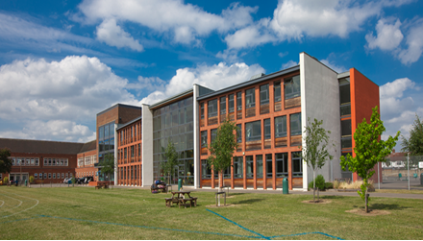
Course starts:
University Induction:
Wednesday September 4th at 9.00am meet your tutors for subject and induction.
School placements:
Lead Partner and Apprentice students start earlier as directed by their lead school
Uni-led students start in school on Friday 20th September - you will find out schools in September.
Notes:
one of the largest providers of teacher education in the UK, working in close partnership with schools across London and beyond
a friendly and supportive university
the only campus-based university within London.

Slide 6

The pattern of the year 2024-25
The course starts on the Monday 2nd September so be ready!!
Induction Wednesday 4th September at 9am to register
Up to 120 days in two different schools
University-led study every Wednesday and some Thursday's in September
Subject sessions/PS on Wednesdays
There will be some directed tasks completed remotely in the first few weeks
Numeracy task
Abyasa training Mon 9th Sept (so LP and App you won’t be in school)
Professional Studies: at Roehampton and in allocated PS hub schools

Slide 7
How it all comes together
Professional Studies
Some school-based training (hubs)
PS sessions at UR
One assignment
Subject pedagogy
Subject sessions
Learning rounds
Two assignments
Two contrasting placements
Increasing timetable
Increasing independence
Increasing pupil progress
Evidence for QTS working with a trained mentor

Slide 8

In readiness – have a watch of this..
Getting Ready for the New Academic Year for Postgraduates (libwizard.com)

Slide 9
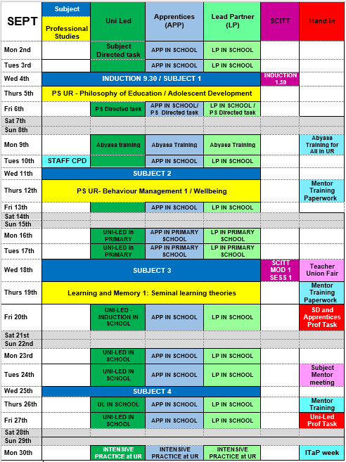
Calendar for 24-25

Slide 10
Conditions:
If you have outstanding conditions, you cannot enrol until these are all met so:
quals certificates - do not wait until Sept either send registered post or come in we have 2 dates – 24th July & 14th August in Lulham reception at 11am.
Equivalency tests - do them NOW!
DOH/Suitability – do not delay.
DBS – you cannot go on placement without it.
You cannot fully enrol, get access to Moodle, email, Abyasa or your ID card without having met these!

Slide 11
DBS – what to do!
If you do not currently have a DBS: You need to complete a DBS check through UoR.
If you have a DBS completed with another organisation and are registered with Update Service: You need to complete an online status check at Roehampton to determine that the certificate is current and valid. UoR will check your subscription is renewed annually, and remains active, or you will not be able to go on placement.
If you have completed a DBS check with another organisation but are not registered with Update Service: You need to complete a DBS check through UoR.
Every student needs to have contacted the DBS team to provide DBS details. See the document DBS Guidance for BA and PGCE students on ITE Programmes which is on the Partnerships Site.
Please send all DBS enquiries to: dbs@roehampton.ac.uk.

Slide 12
Student support
Study support and facilities: Library, Academic
Achievement Team
Tutor team
Financial support: scholarships, budgeting
advice from the SU
Hardship fund
Career support:
writing personal statements, how to apply, interview advice
Employment fairs
Health /wellbeing:
On-campus GP, mental health support, counselling, dyslexia and disabilities
Accommodation:
flat reps assigned to every flat, accommodation team to help with queries or concerns, close to facilities
International support:
Mentoring for students &
Liaison with schools
International team

Slide 13
Contacts for other help:
Admissions: Teachertraining@Roehampton.ac.uk
Health and Wellbeing: wellbeing@roehampton.ac.uk
Student Finance: StudentFinance@roehampton.ac.uk
If subject related: contact your subject lead in the first instance about subject questions or me for anything programme related
Ruth.Seabrook@roehampton.ac.uk for any concerns/worries, if you need help, want advice or not had a response to other emails.

