Slide 1
Introduction to Apleona
Sustainability Manager
Katerina Robinson
April 2023
Realising Potential.
Notes:
Update on identified opportunities

Slide 2

Consumables the supplier confirmed there will be no charges for dispensers
Notes:
As a business we have sourced products based on sustainability for our own premises and a number of client buildings

Slide 3
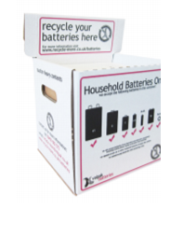
Battery Boxes
6 battery boxes introduced in the library and student kitchens and are getting full. No Cost initiative, which helps to collect this hazardous waste

Slide 4
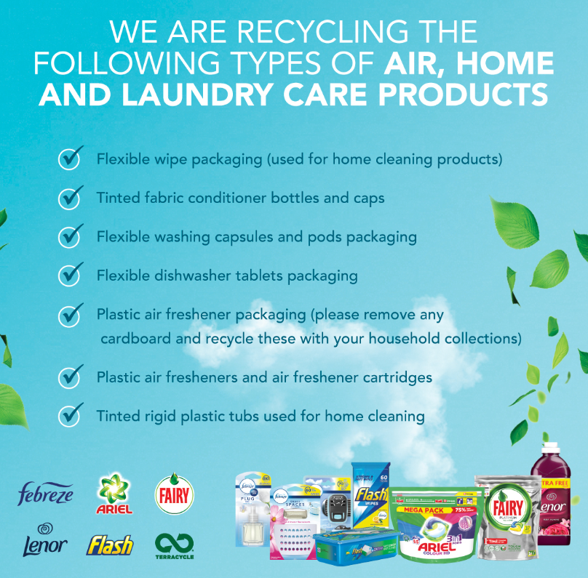
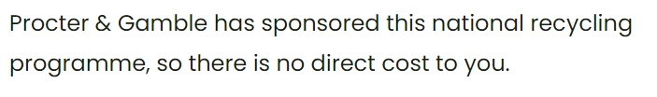
TerraCycle recycling of hard-to-recycle items
5 boxes in laundry rooms, posters used to promote

Slide 5
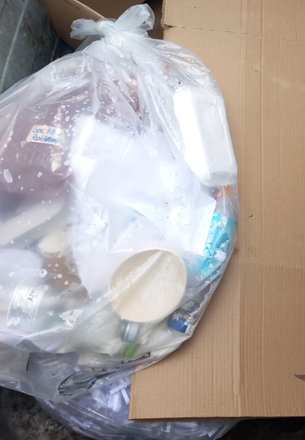
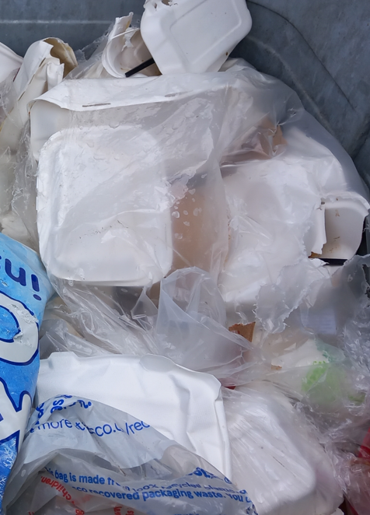
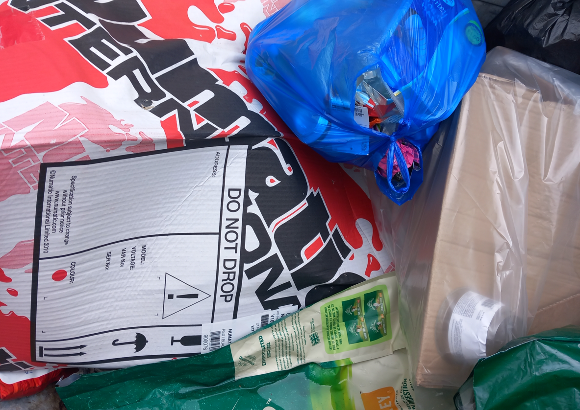
Review of what is 100% recyclable waste
Recent review of waste skips suggests poor waste segregation and confusion of what is recyclable and what is not. Many different types of plastics and food packaging which were placed in the Dry Mixed Recycling - plastic take-away trays and drink cups which are non recyclable as well as juice cartons
Notes:
Lots of glass bottles from hospitality

Slide 6
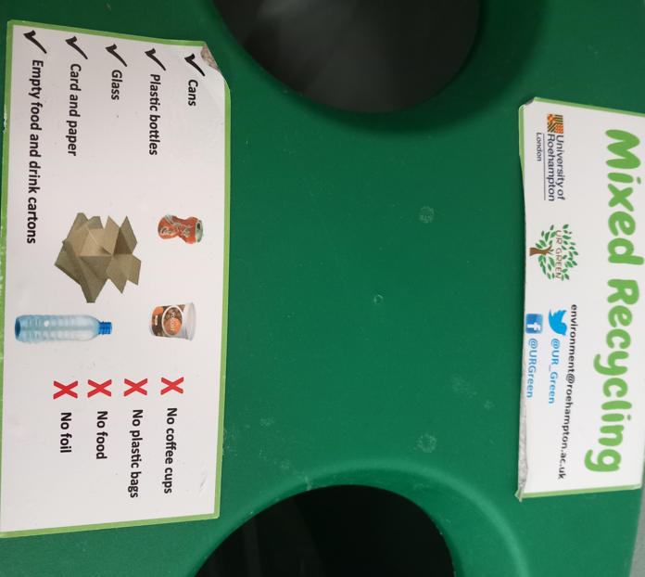
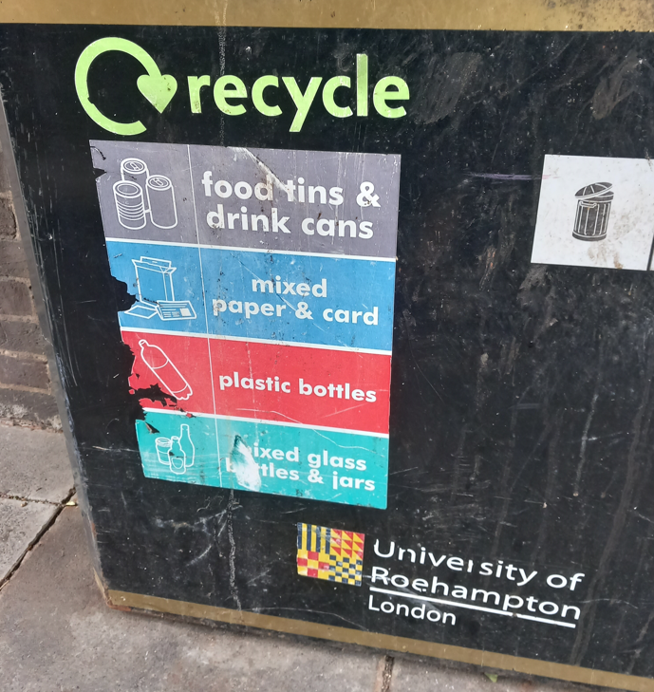
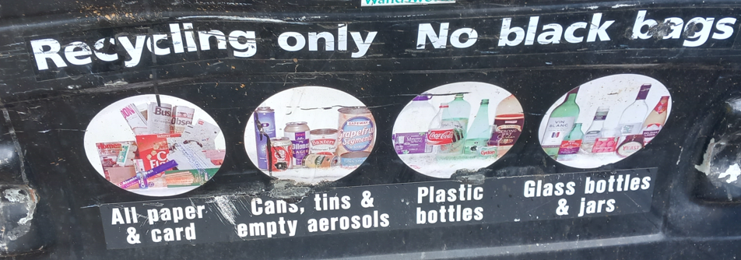
Review of Signage
The current signage on bins and skips suggests that glass bottles and jars can also be placed in the Dry Mixed Recycling bin (along with cans, paper and plastics)
This is quite unusual, as glass is always collected separately
Could we clarify and simplify the signage?
Notes:
Lots of glass bottles from hospitality

Slide 7
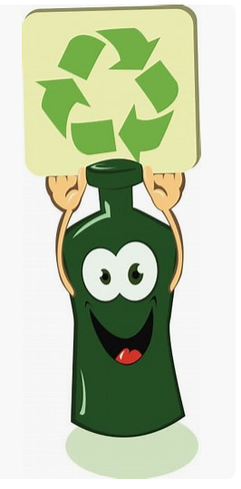
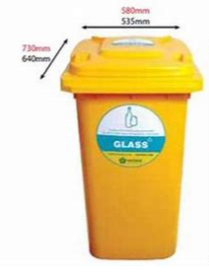
Glass Recycling
Each building has a green bin. Due to the volume of glass bottles and jars, could we introduce a separate bin for glass outside each building, for students to place glass bottles in there? - we need to make it convenient and easy. We could trial this at one or two buildings only first to monitor usage
£6.18 per lift, 240 litre wheelie bin (no charge)
Lucy & Martin Recycling are specialist for glass recycling in London
Glass bottles of any colour will be crushed and recycled in Ilford, only 20 miles away
Glass can be recycled indefinitely, again and again, into new glass
Glass bottles of any colour can be placed in the same bin.
Notes:
Lots of glass bottles from hospitality

Slide 8
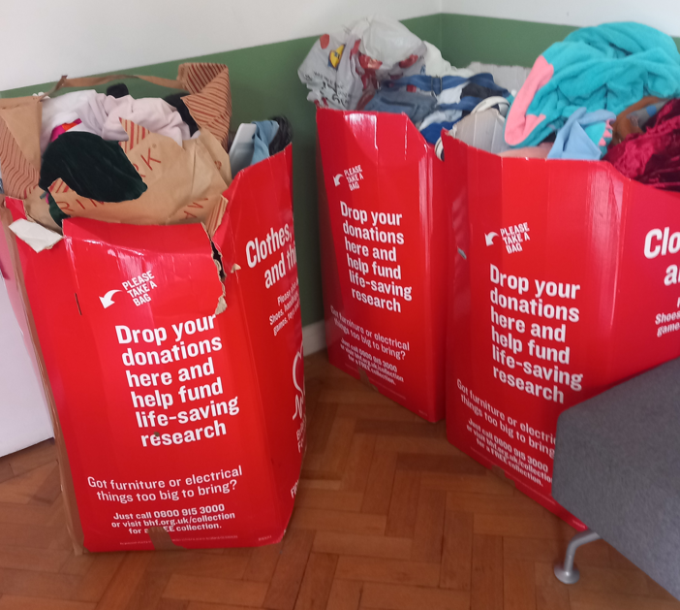
British Heart Foundation
BHF bins in the Chapel for unwanted clothes – well used and already overflowing
10 additional bins ordered, 2 in each Diner area

Slide 9


Volunteering and Fundraising
We would like to support Wandsworth food bank by donating food items. Looking to introduce boxes at the end of May for two weeks
Papyrus can attend an event at the University to discuss their work and support they offer to young people and hopefully fundraise on the day. Freshers’ week?

