Slide 1


An introduction

Slide 2

ABOUT US
182-year history
Four Colleges, established in the 19th Century
Only traditional parkland campus in London
World leading and internationally excellent research
Diverse student community with students coming from 141 countries

Slide 3
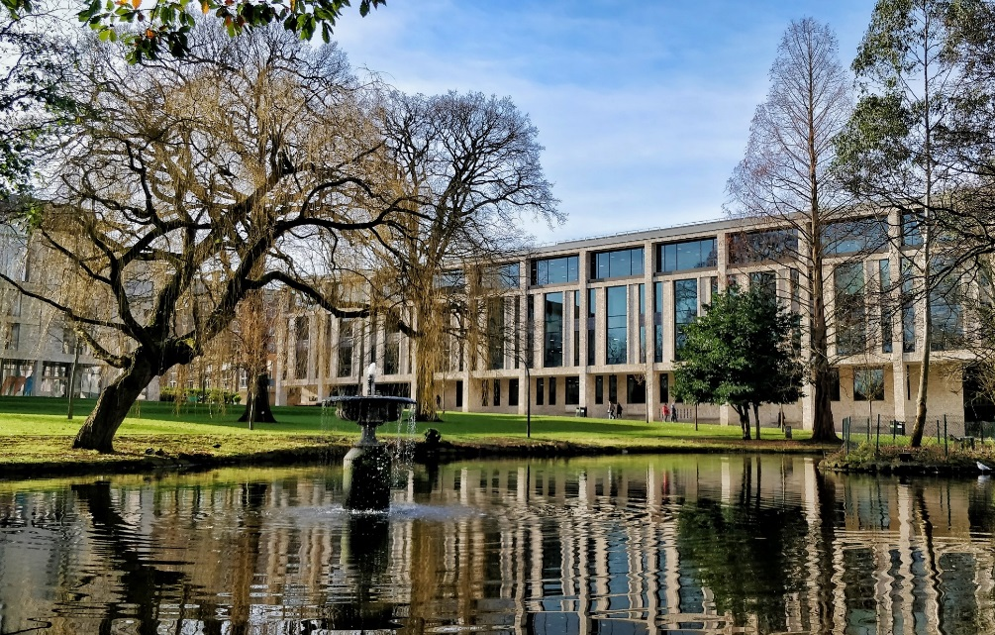
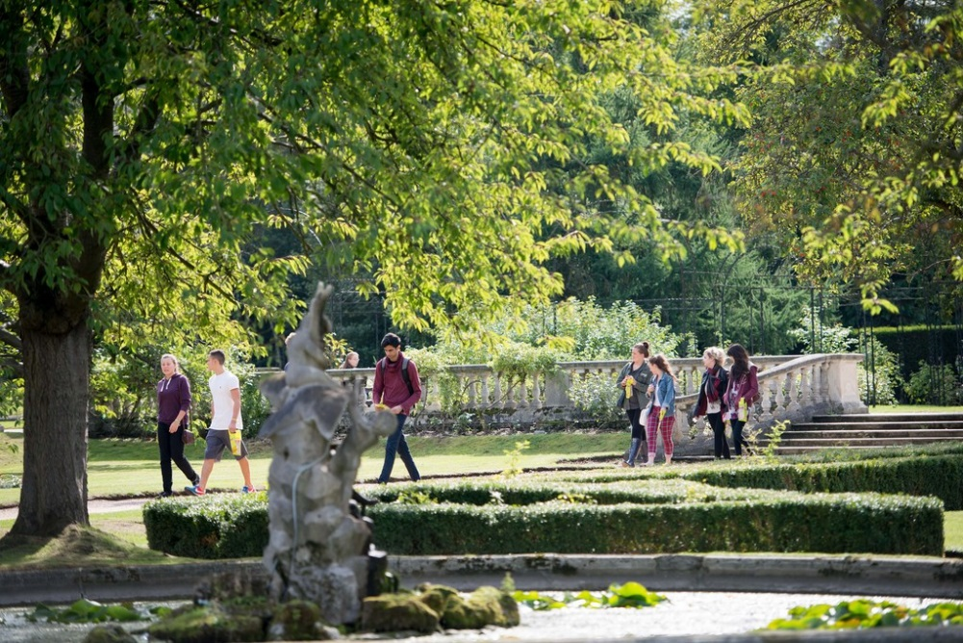
WHERE ARE WE?

Slide 4


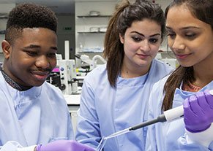

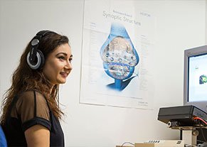

SCHOOLS AND FACULTIES
School of Arts, Humanities, and Social Sciences
Faculty of Business and Law
School of Education
School of Life and Health Sciences
School of Psychology
School of Continuing Education
Graduate School

Slide 5


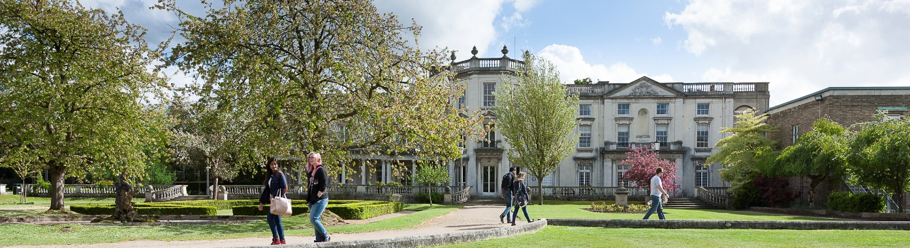
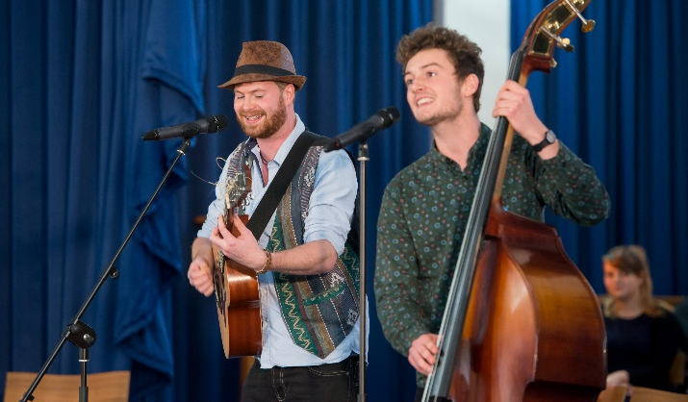
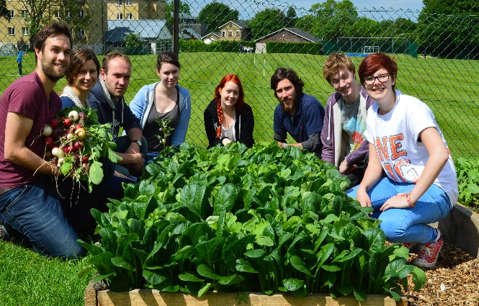
STUDENT LIFE
Students Union
Social events
Sports & Societies
Cafes, food halls, green space
Fresher's Week
Summer Ball

Slide 6
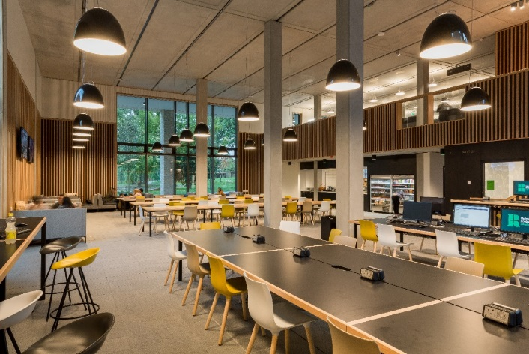
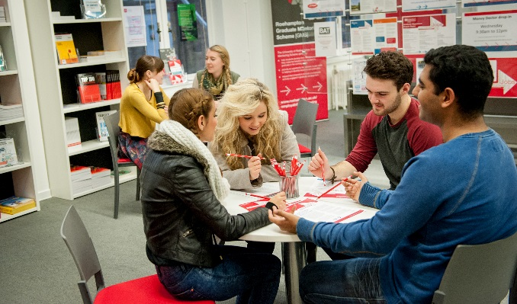
FACILITIES
Library
Gym and Sports on campus
Subject specialist equipment
Students Union
Student shop
Accommodation
NEST

Slide 7
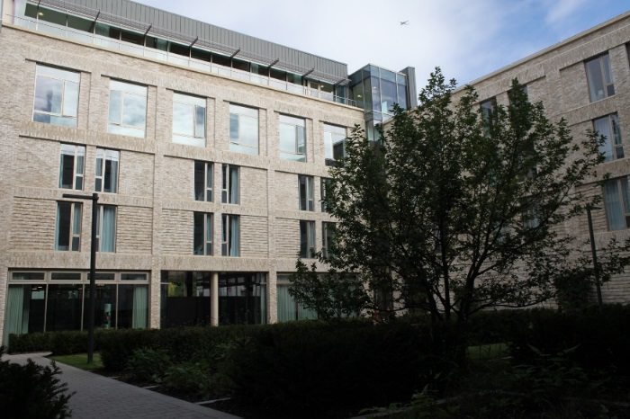
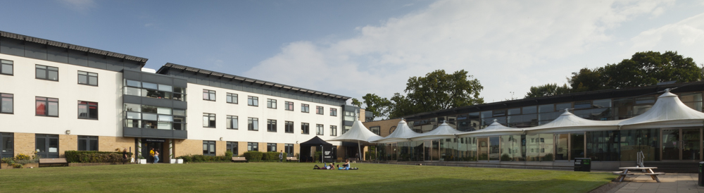

ACCOMMODATION
2000 rooms on campus
Guaranteed (31st July)
Start from £139 per week
All bills included
En-suite or standard rooms
Off campus available too
Apply once offer accepted

Slide 8





STUDY ABROAD
Spend a semester abroad
Available on most programmes
No additional tuition fees
Apply in year 1
We have more than 50 partners
Dedicated study abroad team

Slide 9

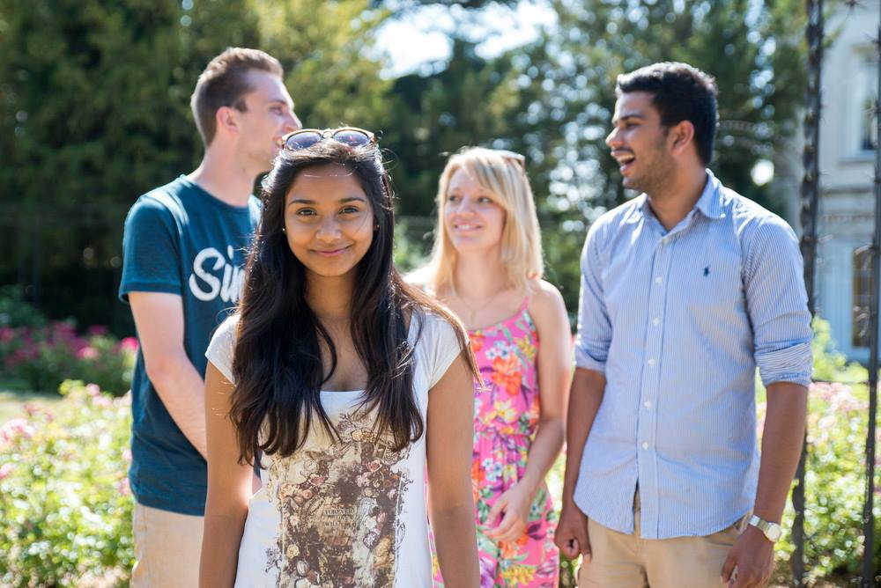


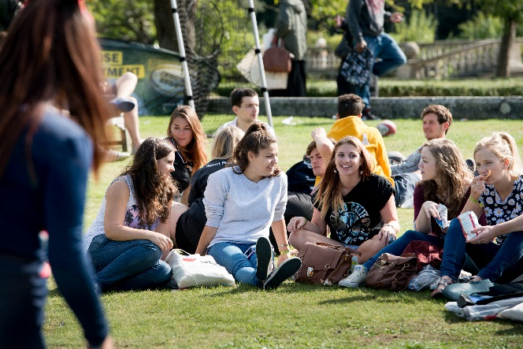
CAREER OPPORTUNITIES
9/10 graduate in employment
Partnerships with industry
Placement, work and internships
Employability and Careers service
Workshops – Interviews/CV’s etc.
Student Ambassador Scheme

Slide 10
WHY Roehampton?
Excellent Facilities
Career support
Wide range of programmes
Best campus in London
Inclusive/supportive teaching style
High quality research active staff

Slide 11



WHAT OUR STUDENTS SAY
“ I feel very lucky to have study at Roehampton and live with people from different parts of the world”
Marah
From USA
“Everyday is new experience and I should keep learning, and keep being open to new experience.
Advise for students from my country: try to get out of your comfort zone”
Zheng Xiaofang
From China
“Roehampton is well located, and has a beautiful campus. The university provided me with a great student experience”
Milad
From Iran

Slide 12
Q
Thank you!
Any questions?

Slide 13





STAY IN TOUCH!
www.facebook.com/roehampton.uni
@Uni_Roehampton #Uni_roehampton
@RoehamptonUni
Uni_roehampton

