Slide 1
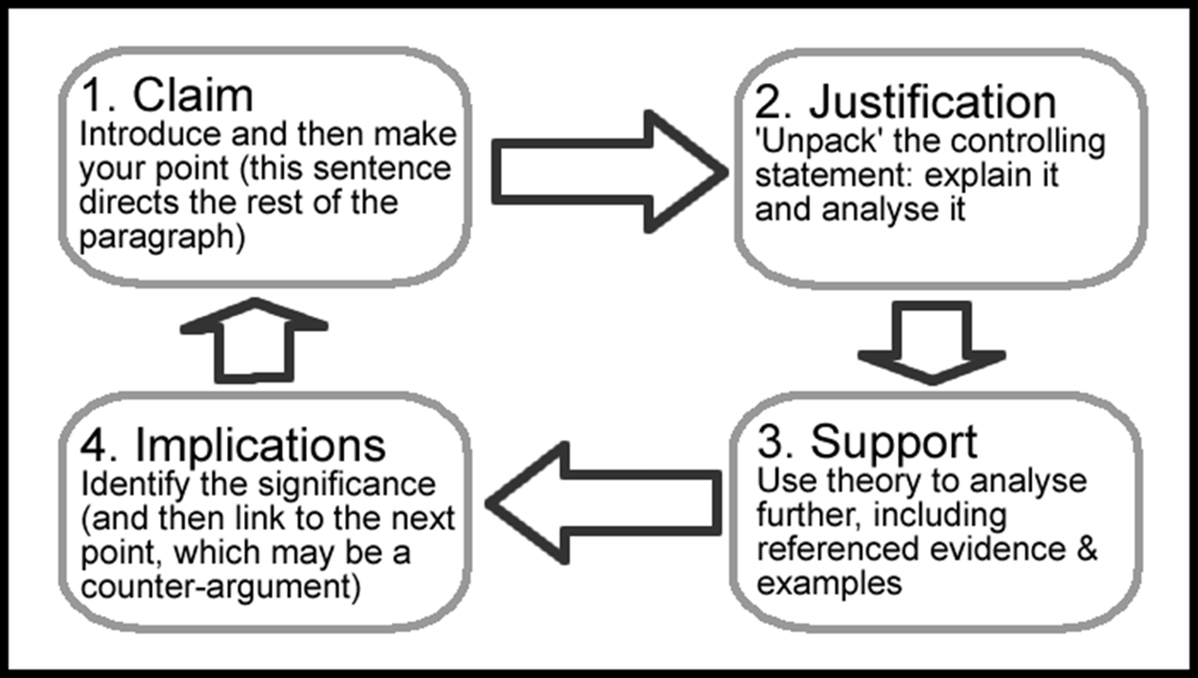
Managing Organisations
Essay writing

Slide 2
I do not know where to start!
Start small; begin with a key text and build up reading.
Once you have an overview, formulate topic sentences to help answer the question.
Read further and fill in the gaps. Be critical and analyse its relevance to the topic as you read.
Follow up references in article as locates further reading and identify links between sources.

Slide 3
Critical Reading
Requires a degree of ‘distance’ from the text
Two readings may be required
1. read for understanding of content
2. close reading which attempts to provide answers to your questions
Look for
Central claims/main points presented
Main evidence
How author substantiates argument
Methodology was used
General weaknesses or strengths
What other leading thinkers or writers have to say about subject

Slide 4
Previewing
(1) Read chapter/journal title – introduces subject
Before you begin reading note down what you may already know. What thoughts/ideas does the title generate?
(2) Read the introduction or first paragraph
This will signpost you to what will be discussed.
(3) Read the conclusion/closing paragraph
Conclusions summarise the key points and provide an answer/overview/make recommendations
(4) Skim subheadings and 1st sentence of each paragraph
Alerts you to the organisation of the chapter and approach/key points addressed by the author
(5) Do not dismiss images, graphs, tables
Can help clarify ideas/confirm understanding

Slide 5
Summarising
Can be understood without re-reading the original
Absorb the meaning of the passage
Identify and record in your own words the key points
Is brief without unnecessary detail
Supports your argument/relevant to your assignment
Write the summary from your notes and reflection, not straight from the original text
Develop writing style
Always use an in-text citation and put details in bibliography

Slide 6
Word count
Introductions and Conclusions = about 10% each.
So, if an essay should be 2,000 words (+/-10%)
Intro & Conclusion = 400 words approximately
This leaves 1600 words
A paragraph is usually about 250-350 words = 5-6 paragraphs.
20% over the word count – automatic fail!

Slide 7
Begin the planning process
Understand the question
Look for the instruction ,content and limiting terms
Talk to your tutor/ALA to clarify
Decide what you already know
Do a mind map/grid/notes to find out what you know to identify the areas that you need to research
Decide what you need to read
‘Smart’ reading techniques : use contents list/chapter headings etc to focus on what will be useful
Take ‘smart’ notes
Write the question in your own words
Get something down on paper!

Slide 8
What your plan should include
Your plan should evolve and develop and show clearly:
Each point you are making in a single sentence (topic.
How each point is going to be developed.
How each point relates to the question (to what extent).
Evidence to support point/s.
The order in which each point occurs.
A few notes to get you started (review reading and lecture notes).
Do not start with introduction and conclusion (do these last: you do not know how you are going to introduce or conclude something until you are clear about what you are going to say).

Slide 9
Paragraph Plan (PEEL)
P – make 1 point per paragraph
Topic sentence
E – Explain and Evidence
Develop your point/explain reasoning. Apply theory/explain cause and effect.
Stepping stone approach – build up your point
Use examples to support/illustrate point
E – Evaluation
Weigh up the points outlined? Do they explain the whole argument/position? No? why not?
What else do we need to consider?
L - Link to question
Draw on the essay title and explain how the point has provided a partial answer to the question. Then explain what point you will be making in the next paragraph

Slide 10
Paragraph Plan

Slide 11
Example Paragraph
There seems to be a link between personality and job satisfaction, although there are different views about how strong this link is. One study on emotional regulation has demonstrated that there is a strong link between how we regulate emotions at work and how satisfied we are with our jobs (Cote & Morgan, 2002, cited in Robinson, 2008). The findings showed that workers exaggerate positive emotions more than they hide negative feelings. A further study (Jones et al., 2012) also found that suppressing negative emotion led to less job satisfaction and amplifying positive emotions led to greater social interaction at work. These findings would suggest that those that are good at regulating their emotions, particularly if they are able to be positive, will have a higher job satisfaction than someone who cannot amplify positive emotions. Although emotional regulation is not synonymous with personality, it seems likely that personality type is linked to emotional regulation and, therefore, job satisfaction.

Slide 12
Structuring your ideas
Examples of ways you might structure your literature review are:
chronologically; although be careful not just to list items; you need to write critically, not just descriptively;
by theme; this is useful if there are several strands within your topic that can logically be considered separately before being brought together;
by sector e.g.: political background, practice background, methodological background, geographical background, literary background;
by development of ideas; this could be useful if there are identifiable stages of idea development that can be looked at in turn.
Once you have established your structure you need to outline it for your reader.

Slide 13
Introductions
View the essay as a debate/ a dialogue
What is your objective/focus?
Present definitions of key terms
Be clear what your line of argument is
Set the scene – establish the context of the question
Answer the questions that start with ‘what’, ‘who’, ‘when’ and ‘where’. The answers will generate background information and provide a context to your writing
Notes:
Show example introduction

Slide 14
Conclusions
Do not just stop.
Summarise main points, do not simply regurgitate the same information (proofreading for structure may help).
Read your essay as you would a chapter, summarising each paragraph – what is my argument here?
Draw threads of your overall argument together.
Do not introduce new information.
It should be a reflection of your introduction.
Come to an overall conclusion – now I have written this essay, what conclusions can be made about this topic?
Answer the question!

Slide 15
Proofreading
Leave your essay for a couple of days, then read it twice
Once for grammar - Have you said what you mean? Read aloud emphasising where the punctuation is.
Once for structure – Introduction, main body and conclusion, summarising main points by paragraph. This may help with your conclusion.
If you can, get someone else to read your essay as there may be mistakes you have missed.
Many students lose marks for poor written English because they simply have not taken the time to proof read their essays.

Slide 16
Coherence test
Create a spare copy of your essay
Delete everything EXCEPT:
Introduction, topic sentences, conclusions.
Can you identify the development of your argument?
Does it answer the thesis statement?
If yes, you have a coherent essay.

Slide 17
Analysis | Evaluation
‘How’ requires consideration of the ways that something operates – processes and procedures. | ‘What if’ allows you to consider the implications or results of an action.
‘Why’ requires you to find reasons, explanations or causes. ‘Why’ questions can only be answered over time through wide reading which builds upon existing scholarship. | ‘So what’ helps you to think through or justify your own position and discuss the implications ‘What next’ may be considered if recommendations are required.
Both questions if answered appropriately will result in the analysis of the argument. Requires you to consider alternative responses to a position. | These questions result in the evaluative phase of your essay considering implications, solutions, conclusions and recommendations.

Slide 18
Assessment and Feedback
Structure
Problems with the introduction or conclusion, paragraphs too long or too short?
Lack of coherence/repetition?
Tone
Contractions, pronouns, informal language, colloquialisms
Content
Lack of understanding of question, relevance, answer unclear
Analysis
Too descriptive, needs to be more critical and/or analytical
Grammar, Punctuation & Spelling
Commas, semicolons, tense, plurals, spelling mistakes
Written English
Comma splice, incomplete sentences, unclear sentences, inaccurate vocabulary
Referencing/Bibliography
Bibliography incomplete, referencing issues, sources are unclear

