Slide 1
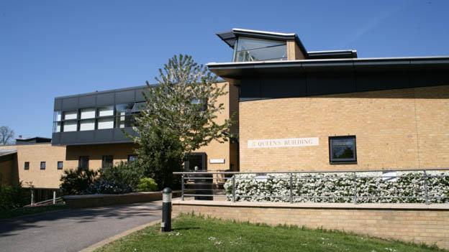
Schiller Academic Workshops
Paris 22nd September 2014
Heidelberg 24th September 2014
Madrid 26th September 2014
Dr Guy Bohane – University of Roehampton Business School
Bridget Middlemas - University of Roehampton Department of Academic Enhancement

Slide 2
Overview of the workshops
Part 1 – Assessment criteria for Business Degrees
(Case study Managing Organisations)
Undergraduate Assessment Criteria
Academic guidance to students on an assessment
Case study Year 2 UG ‘Managing Organisations’ essay
Matching learning outcomes to the marking criteria
Coursework exemplars & marking exercise
Grading and the spread of marks
Utilising different assessment formats
Internal and external moderation
Part 2 – Supporting dissertations and dissertation module design
The Dissertation module
Briefing and instructions
Supporting students
Planning and the Literature Review
Records and ethics
Viva arrangements
Assessment and feedback sources
Marking exercise

Slide 3
Website for this training http://www.roehampton.ac.uk/Schiller_University

Slide 4
Part 1 – Assessment criteria for UG & PG Business Degrees
Part 1 – Assessment criteria for UG & PG Business Degrees (Case study - Managing Organisations Year 2 UG)
Undergraduate Assessment Criteria
Academic guidance to students on an assessment
Case study Year 2 UG ‘Managing Organisations’ essay
Matching learning outcomes to the marking criteria
Coursework exemplars & marking exercise
Grading and the spread of marks
Utilising different assessment formats
Internal and external moderation

Slide 5
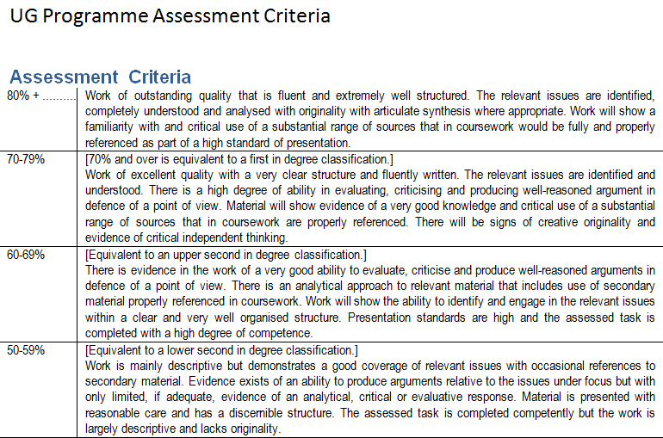

Slide 6
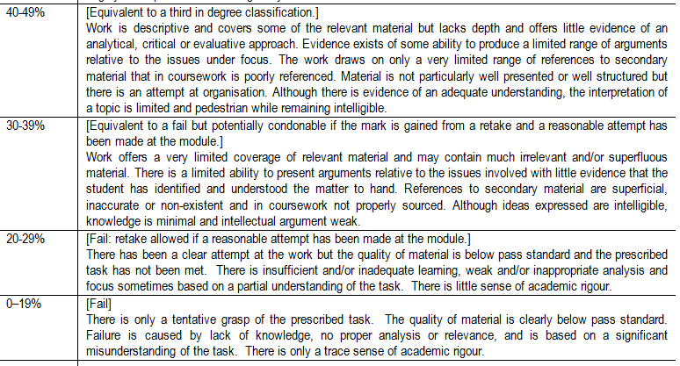
Business UG Assessment Criteria p2

Slide 7
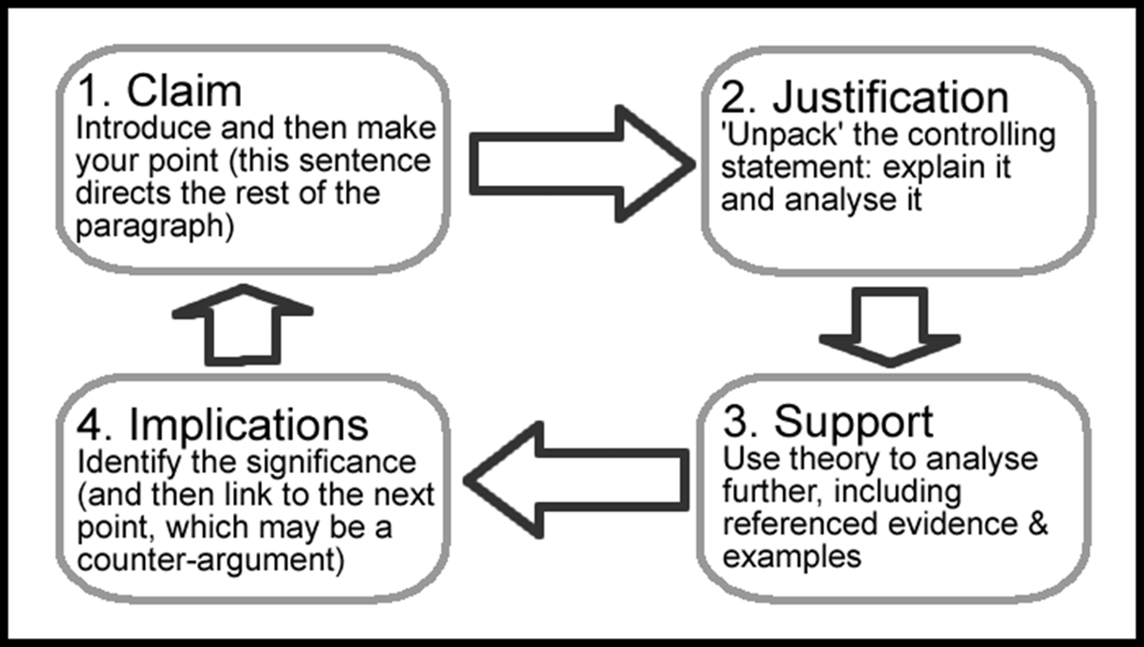
Managing Organisations
Academic guidance on an assessment
Case study - Managing Organisations
– Essay Writing Guidance
Yr 2 UG
Essay writing
Resource D

Slide 8
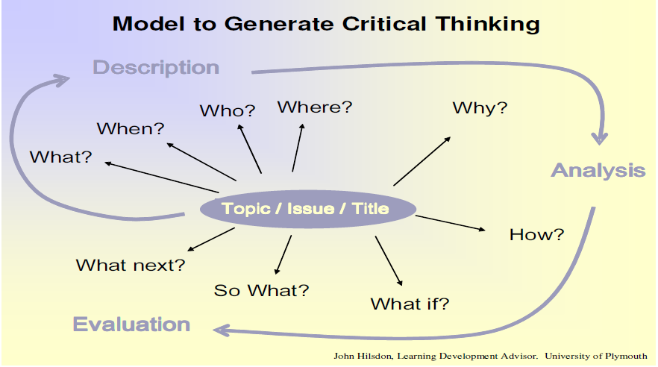
Academic guidance on an assessment Managing Organisations – Essay Writing Guidance Yr 2 UG
Resource E

Slide 9
Case study - Managing Organisations
Resource A
MODULE RATIONALE
The module encourages a critical examination of an integrated approach to the management of a business organisation in the private, public and SME sectors. Students will examine and apply principles, theories and techniques of operations management, human resource management, financial management and budgeting across different functions within organisations. These will also be applied in terms of students’ career development.
Module LEARNING OUTCOMES
Students who successfully complete this module will be able to:
1. Explain and evaluate the relationship between management theory and practice;
2. Demonstrate and understanding of key developments in management theory;
3. Understand the role of managers in organisations as well as differences in management styles;
4. Evaluate the nature of leadership and the moral and ethical dimensions of management,
5. Demonstrate research skills by secondary research;
6. Understand and apply different tools for business and management analysis;
7. Demonstrate communication skills, both oral and written;
8. Identify and develop the management skills needed to work with and through other people;
9. Appreciate and apply factors which contribute to effective group working and decision-making in the management of change ;
10. Reflect on their own and other people’s experience of working in a group and analysed these reflections with reference to relevant theories.

Slide 10
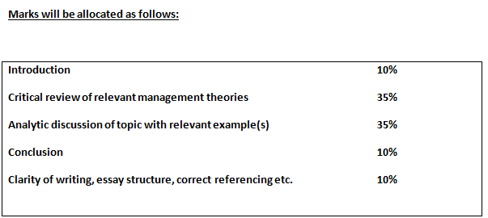
Case study – Managing Organisations Essay
Individual Essay: 2,000 words (35% weighting)
Answer ONE from the following option of four assessment topics:
Critically appraise the importance of effective operations management in increasing productivity in food retailing.
Identify a recent example of dubious corporate behaviour in a business in the UK. Compare and contrast the ethical issues and business risks raised by the behaviour from three key stakeholders’ perspectives.
With the aid of specific real life organisational examples in the leisure sector, critically evaluate the alternative strategic growth paths available to leisure organisations as identified by Ansoff’s matrix.
Assess the benefits of teams in an organisation of your choice, by applying two different theories of team development. Discuss the advantages and disadvantages of the two theories in this context.
Resource B

Slide 11
Case study - Managing Organisations Assessment Rubric
Resource C

Slide 12
Coursework Exemplar: Examples of student essay Resource F
Assess the benefits of teams in an organisation of your choice by applying two different theories of team development. Discuss the advantages and disadvantages of the two theories in this context.
The purpose of this essay is to assess the benefits of teams and to apply theories of team development. Teams are typically a small (10-15) unit of people with a specific set of skills that have come together to achieve a common goal. Work teams can also be generally defined as an interdependent collection of individuals (Hackman, 1980). The organisation of focus within this essay will be on Microsoft, founded by Bill Gates. Microsoft is a software and computing cooperation that also helps businesses realise their full potential (Microsoft). Like any other company, Microsoft is built up by hundreds of individuals that have to work together in harmony in order to function properly and to meet company goals. It is vital that individuals are capable to not only work efficiently on their own but also able to come together as a team and to compromise and communicate well. Good team management means the outcome of good team performance which is being proven to be the key building blocks within organisations (Boddy, 2011). The essay will explore two different theories concerning team development and analyse how applicable it is for this particular team structure. The two ideas of focus will be on Belbin’s team roles and Tuckman’s team development theories as well as mentioning the advantages and disadvantages of both.
Refer to Appendix I for full exercise

Slide 13
Examples of student essay Resource G
Managing Organisations
Identify a recent example of dubious corporate behaviour in a business in the UK. Compare and contrast ethical issues and business risks raised by the behaviour from three key stakeholders’ perspectives.
In this assignment I will be identifying a dubious corporate behaviour in a business within the UK; I have chosen to discuss Tesco and its recent horse meat scandal. I will be comparing the ethical issues and business risks raised by the behaviour of three key stakeholder’s perspective and how it affected Tesco as an organisation. The three stakeholders I have chosen to look into would be the customers of Tesco, the suppliers and the government.
Refer to Appendix I for full exercise.

Slide 14
Coursework exemplars and marking exercise
Task
Review the essays (Resource F & G) and in pairs consider the following questions:
Using the rubric (Resource C), assess the grading for the student in different assessment categories (each pair to assess a different criteria e.g. Introduction; Critical Theory; Discussion; or Conclusion).
Report back your findings to the group.
Do the essays meet the key learning outcomes?
List the key challenges in undertaking this exercise

Slide 15
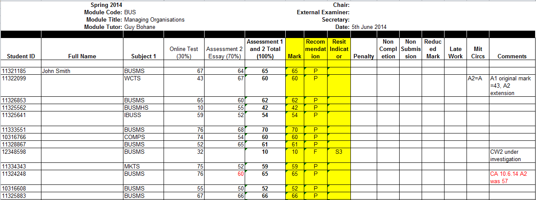
Grading and the spread of marks Case study – Managing Organisations Year 2 UG

Slide 16
Utilising different assessment formats
Presentations
Posters
Peer review and debates
Online assessments
Reflective logs and diaries
Simulations
Live case studies
See also web references (Source S)
Resource R & S, and our new web pages

Slide 17
Web sources for assessment and feedback
ASKE at Oxford Brookes University, UK, a useful source of information and resources about assessment and feedback http://www.brookes.ac.uk/aske/
Gibbs, G (2009) Assessment of Group Work – Lessons from the Literature at: http://www.brookes.ac.uk/aske/documents/Brookes%20groupwork%20Gibbs%20Dec%2009.pdf
Higher Education Academy – resources on assessment and feedback at: https://www.heacademy.ac.uk/workstreams-research/themes/assessment-and-feedback
Higher Education Academy – resources on employability at: https://www.heacademy.ac.uk/workstreams-research/themes/employability
QAA (2014) Skills for Employability at: http://www.qaa.ac.uk/assuring-standards-and-quality/skills-for-employability
QAA (2014) a short DVD on the UK Quality Code for Higher Education at: http://www.qaa.ac.uk/publications/films/film?PubID=175
QAA Undergraduate Benchmark Statement for Economics (BA, BSc) at: http://www.qaa.ac.uk/en/Publications/Documents/Subject-benchmark-statement-Economics.pdf
QAA Undergraduate Benchmark Statement for Politics & International Relations (BA, BSc) at: http://www.qaa.ac.uk/en/Publications/Documents/Subject-benchmark-statement-Polictics-and-international-relations.pdf
QAA Postgraduate Benchmark Statement for Business and Management (MBA, MA, MSc) at: http://www.qaa.ac.uk/en/Publications/Documents/Subject-benchmark-statement-Masters-degrees-in-business-and-management.pdf
QQA, An Introduction to the Bologna Framework at: http://www.sqa.org.uk/files_ccc/EQFLeaflet.pdf
World Education News and Reviews (WENR) 2014; 15 years of Bologna, a review at: http://wenr.wes.org/2014/06/towards-a-european-higher-education-area-15-years-of-bologna/
Bridget Middlemas & Guy Bohane, University of Roehampton, 2014

Slide 18
Internal and external moderation
The internal moderator at Schiller
The University of Roehampton moderator
The external examiner

Slide 19
The role of the moderator (Roehampton)
The University monitors the operation and development of the programmes it awards collaboratively – whether through validation, franchise or joint delivery – by means of internal moderators.
They are integral to the processes of quality assurance with external partners and report on these and other aspects of the collaborative relationship on an annual basis.

Slide 20
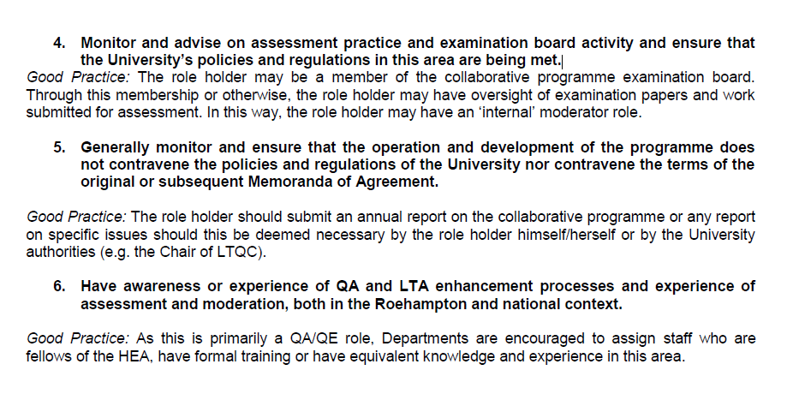
Role of the moderator

Slide 21
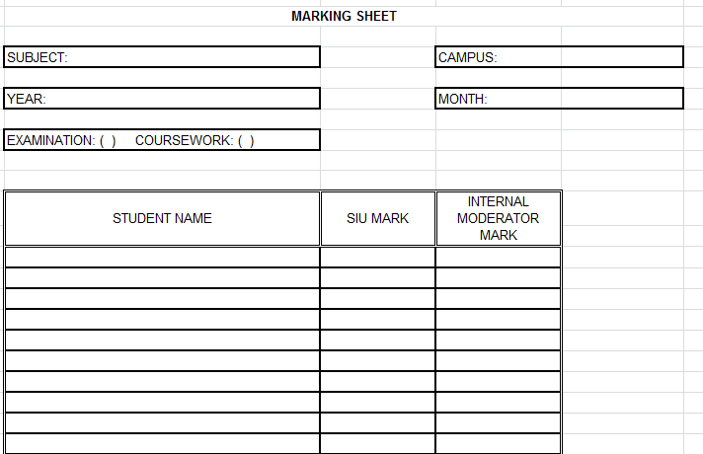
Moderations and marking sheets

Slide 22
2:2
2:1
3rd

Slide 23
External Examiners at the University of Roehampton
The main purpose of the external examiner is to assist the University in discharging its responsibility for the quality and standards of the education it provides and the awards it offers by:
assisting in the comparison of academic standards across higher education awards and institutions;
verifying that standards are appropriate for the particular award for which the external examiner takes responsibility;
ensuring that the assessment process is fair and fairly operated in the marking, grading and classification of student performance;
providing externality of opinion and objective advice in cases which are difficult to resolve.

Slide 24
Part 2 – Supporting dissertations and dissertation module design
Part 2 – Supporting dissertations and dissertation module design
The Dissertation module
Briefing and instructions
Supporting students
Planning and the Literature Review
Records and ethics
Viva arrangements
Assessment and feedback sources
Marking exercise

Slide 25
The Dissertation module briefing UG - Rationale
The module provides you with an opportunity to undertake a significant piece of independent research, where you can extend and apply your knowledge in a chosen research area, develop your capacity for creative and innovative thinking and further enhance your analytical skills.
In addition the module consolidates skills of time management and report writing. As a tutored (not taught) module it reinforces autonomous learning
40 credits
10,000 words

Slide 26
Dissertation module – Learning outcomes (UG)
Students who successfully complete this module will be able to:
1. construct a research question or hypothesis;
2. compose a relevant review of the literature;
3. appreciate the problems of applying business concepts and theories to organizational issues;
4. consider and select suitable research methods;
5. design and apply appropriate methodology that includes both secondary and primary research;
6. present data and information in a clear and logical way;
7. select and evaluate research material;
8. determine alternatives to organizational issues;
9. select, evaluate and substantiate conclusions;
10. offer recommendations where the terms of reference call for them;
11. summarise the dissertation and
12. offer a written and oral critique of their performance on this assignment
World Education News and Reviews (WENR) 2014; 15 years of Bologna, a review at: http://wenr.wes.org/2014/06/towards-a-european-higher-education-area-15-years-of-bologna/

Slide 27
Dissertation modules – Assessment criteria
Introduction and objectives 10%
Literature review 20%
Methodology 15%
Results Analysis and discussion 25%
Conclusions and recommendations 10%
Overall structure and presentation 10%
Viva 10%

Slide 28
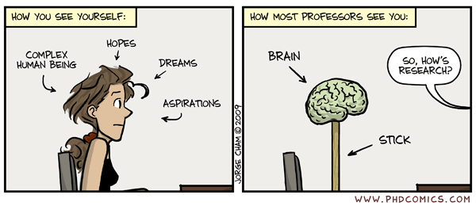
Supporting students
Cartoon here

Slide 29
Dissertations – Working with supervisors
Resource M

Slide 30
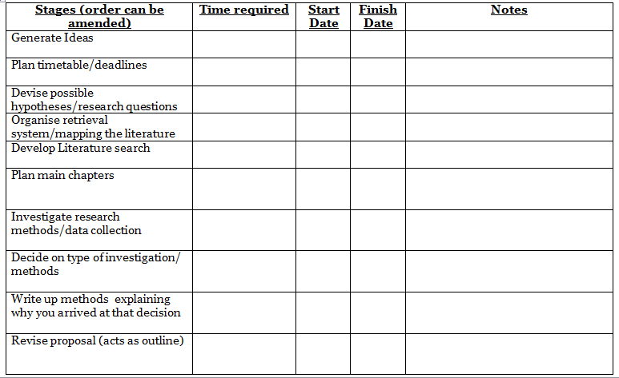
Dissertation Planner (extract)
Resource K

Slide 31
Approaching the literature review
To complete a literature review requires planning, time, reading, writing, drafting, reflection and editing.
A successful literature review has a firm idea of the research problem and an understanding of the research framework/paradigm.
In order to refine the research problem, conduct preliminary research which will help you narrow your focus and identity key search terms.
Resources H i & ii

Slide 32
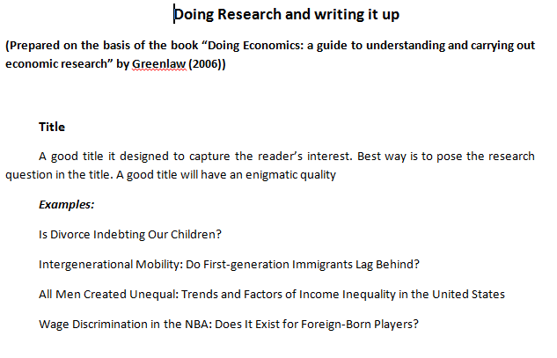
Dissertation module -
Resource K

Slide 33
Writing a Literature review (Extract)
Resource Hiii

Slide 34
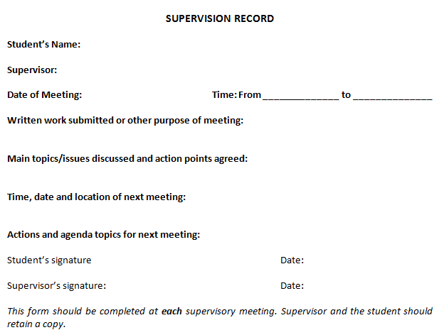
Dissertation Supervision Record (PG)

Slide 35
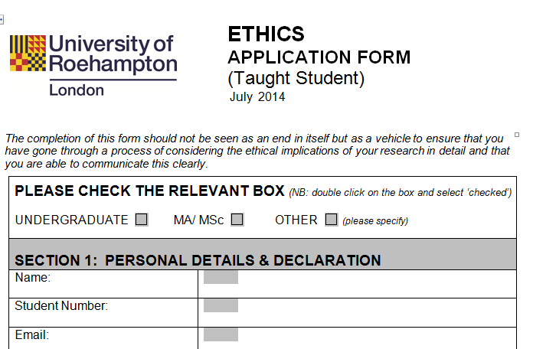
Dissertation ethics
Resource L

Slide 36
Dissertation ethics
Ethics Form
Ethical Issues
Many of you will be conducting research that goes beyond reading literature and there will therefore be important ethical issues to consider.
What are the ethical issues relating to the work you propose to carry out for your project? How do you propose to address them and deal with them? If you conducting research using published sources we still require you to make a statement about whether or not there are any ethical considerations.
Short statement concerning ethics:
I have discussed with my supervisor all ethical issues arising out of my project. If my dissertation changes in any way I will re-discuss any ethical issues with my supervisor.
Name of student:
Student number
Signed (student)………………………………………………………………Date
Signed (supervisor) Date................

Slide 37
Dissertation Viva arrangement

Slide 38
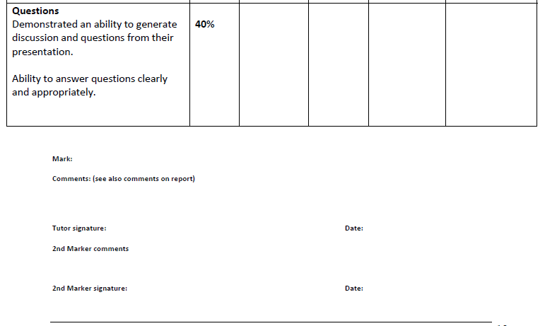
Dissertation Viva arrangement

Slide 39
Dissertation samples
Sample 1:Title: ‘Corporate social responsibility and food wastage’.
Sample 3: Title: ‘Restless youth: Investigating factors that affects graduates transition intentions into employment and postgraduate study’.
Resources N & O

Slide 40
Dissertation marking exercise (2 samples UG Dissertations)
Review the extracts of the two dissertations (see appendix 2). Give the students a grade for one of the marking criteria on the marking pro-forma provided.
The group will compare the marks and discuss the justifications for the grades.

Slide 41
Appendix I – UG marking exercise
Task
Review the essays (Resource F & G) and in pairs consider the following questions:
Do the essays meet the key learning outcomes?
Using the rubric (Resource C), assess the grading for the student in different assessment categories (each pair to assess a different criteria e.g. Introduction; Critical Theory; Discussion; or Conclusion).
Report back your findings to the group.
List the key challenges in undertaking this exercise

Slide 42
Appendix II – Dissertations marking exercise
Review the extracts of the two dissertations. Give the students a grade for one of the marking criteria on the marking pro-forma provided.
Sample 1:Title: ‘Corporate social responsibility and food wastage’.
Sample 3: Title: ‘Restless youth: Investigating factors that affects graduates transition intentions into employment and postgraduate study’.
The group will compare the marks and discuss the justifications for the grades.
http://www.bbc.com/news/uk-24603008

Slide 43
Appendix III - List of Resources
Resource A – Managing Organisations (Module Booklet)
Resource B – Managing Organisations essay briefing
Resource C – Managing Organisations assessment rubric
Resource D - Essay Writing Guidance (Managing Organisations Year 2 UG)
Resource E - Critical Thinking
Resource F - Essay sample (good)
Resource G – Essay sample (weak)
Resource H – i Approaching the literature review (dissertation) powerpoint
– ii Approaching the literature review (dissertation) handout
– iii Writing a literature review (dissertation) powerpoint
Resource I - Dissertation planner
Resource J – Autumn checklist
Resource K – Doing research and writing up handout
Resource L – Dissertation ethics
Resource M – Working with supervisors
Resource N – Dissertation sample PG (pass)
Resource O – Dissertation sample PG (fail)
Resource P – Dissertation viva arrangement
Resource Q – TAPPS mapping activity
Resource R – Assessment Ideas
Resource S – Some useful web refernces for assessment and feedback
Resource T - QAA Benchmark Statement for Masters Degrees in Business & Management (in UK Universities)
Resource U – PG Dissertation marking proformas
Resource V – Sample Dissertation Feedback sheet PG Student S
Resource W - Sample Dissertation Feedback sheet PG Student A
Resource X – Assessment – Formative & summative
Resource Y – QAA Economics Benchmark
Resource Z – QAA Economics Benchmark statement

Slide 44
Thanks for participating!
g.bohane@roehampton.ac.uk
b.middlemas@roehampton.ac.uk

